Slide 1

PLURAL OF NOUNS
flower - flowers / bus – buses / man - men

Slide 2


NOUN +
S
Singular = 1 (one) Plural = 2 + (two or more)
a flower flower
a week week
a nice place nice place
this hat these hat
S
S
S
S
a flower
flowerS

Slide 3
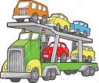
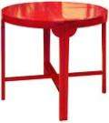

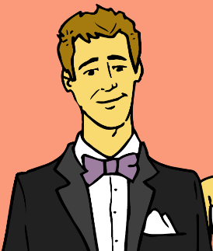







Examples:
a car
carS
a table
a husband
husbandS
tableS
a cap
capS
a house
houseS
a pen
penS

Slide 4

Write these nouns in the plural.
a car |  | a flat |  | a village
a balloon |  | a duck |  | a pencil
a chair |  | a goat |  | a mother
a bag |  | a ball |  | a stamp
a river |  | a town |  | a nose
a belt |  | an apple |  | a leg

Slide 5
Spelling
-es
bus – buses, dish – dishes, church – churches, box - boxes
potato - potatoes
baby – babies, dictionary – dictionaries, party – parties
day – days, monkey – monkeys, boy - boys
shelf – shelves, leaf – leaves, wife - wives
-s/-sh/-ch/-x
-o
-y
-ay/-ey/-oy
-f/ -fe
-es
-ies
!
-ys
-ves

Slide 6




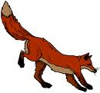
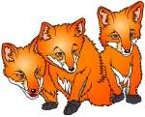
Examples:
a tomato
tomatoES
a church
babIES
a baby
a fox
foxES
churchES
a wolf
wolVES
flIES
a fly
busES
a bus
a scarf
scarVES

Slide 7




NOUNS OF FOREIGN ORIGIN ending in – O just add - S
a radio
radioS
a piano
pianoS
an avocado
ZOOS
a video
videoS
a ZOO
avocadoS

Slide 8
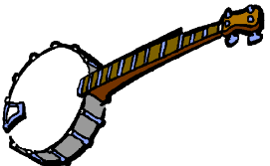
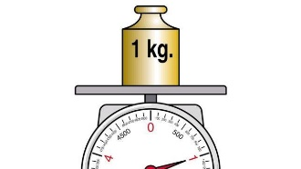

studioS
kangarooS
a kangaroo
a studio
an expo
expoS
a photo
photoS
kiloS
a solo
a banjo
soloS
a kilo
banjoS

Slide 9

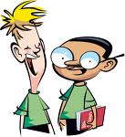
singular nouns ending in VOWEL + -Y just add - S
donkeyS
a boy
a donkey
a key
boyS
keyS
a toy
toyS
a turkey
a play
playS
turkeyS

Slide 10
some singular nouns ending in – F or
– FE just add - S
roofS
giraffeS
a roof
a giraffe
a sheriff
cuffS
a cuff
a cliff
sheriffS
cliffS
safeS
a safe

Slide 11
Write these nouns in the plural.
a tomato |  | a lady |  | a city
a leaf |  | a gulf |  | a hero
a day |  | a valley |  | a half
a wife |  | a dress |  | a boss
a country |  | a hippo |  | a brush
a box |  | a class |  | a potato

Slide 12
Irregular plural forms
a man – men
a woman – women
a child – children
an ox – oxen
a mouse – mice
a louse – lice
a foot – feet
a tooth – teeth
a goose – geese
one sheep – two sheep
a deer – two deer
a fish – two fish
a dozen – two dozen
means – means
series – two series
species – different species
headquarters – headquarters
crossroads – crossroads
+
a person - people

Slide 13




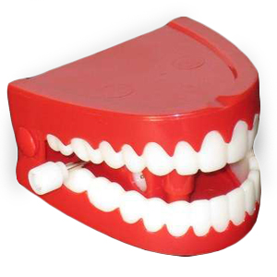
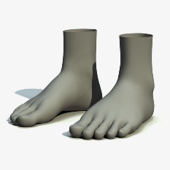
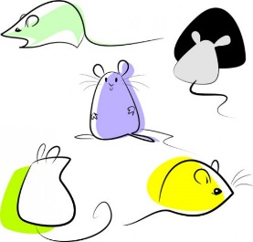
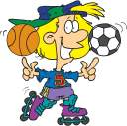
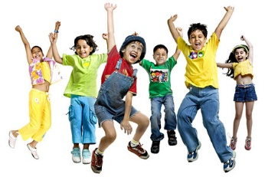

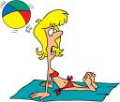

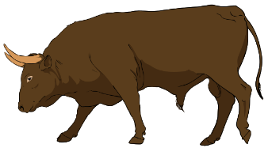
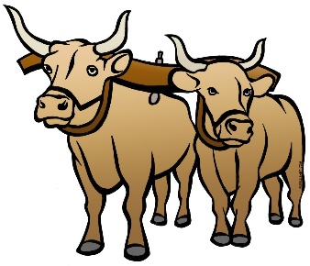
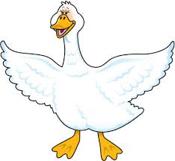
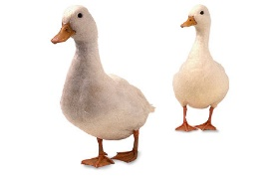
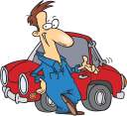

Examples:
a foot
a sheep
shEEp
fEEt
a tooth
tEEth
mice
a child
children
a woman
womEn
a mouse
an ox
mEn
a goose
gEEse
a man
oxen

Slide 14
Write these nouns in the plural.
a man |  | a mouse |  | a foot
a person |  | an ox |  | an aircraft
a fish |  | a child |  | a dozen
a deer |  | a sheep |  | crossroads
a goose |  | a woman
a louse |  | a tooth

Slide 15
Make plurals:
flower
boat
woman
city
umbrella
address
knife
sandwich
family
foot
potato
holiday
flowers
boats
women
cities
umbrellas
addresses
knives
sandwiches
families
feet
potatoes
holidays

Slide 16

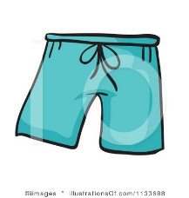
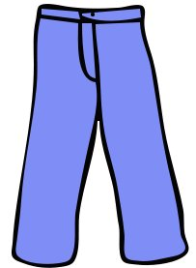

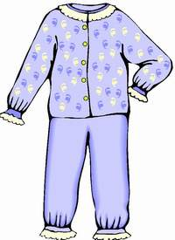
Some nouns are always plural
trousers
shorts
jeans
pants
tights
pyjamas
glasses
scissors
You can use A PAIR OF with these nouns.

Slide 17
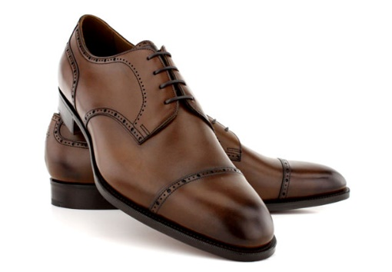
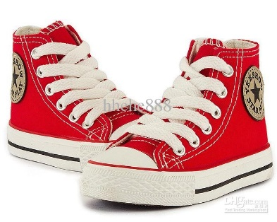



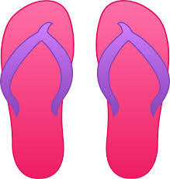
Some nouns are usually plural
shoes
sandals
boots
slippers
chopsticks
gloves
socks
mittens
flip-flops
trainers

Slide 18
Change the sentences into the plural form.
The baby sleeps. ____________________________________________________
This animal is an ox. ___________________________________________________
His foot is very big. ____________________________________________________
That woman is beautiful. _____________________________________________
The child has got a white tooth. _______________________________________
This country has many inhabitants. ___________________________________
This toy is educational. ________________________________________________
There is a bench in the park. __________________________________________
That man eats a berry. ________________________________________________
A calf is eating a leaf. ________________________________________
A wife cooks a lunch. ________________________________________
There is a scarf on the shelf. __________________________________

Slide 19




