Slide 1

Guess the word
?

Slide 2

Umbrella

Slide 3
Bed

Slide 4
Breakfast

Slide 5

Apple

Slide 6

Pen

Slide 7
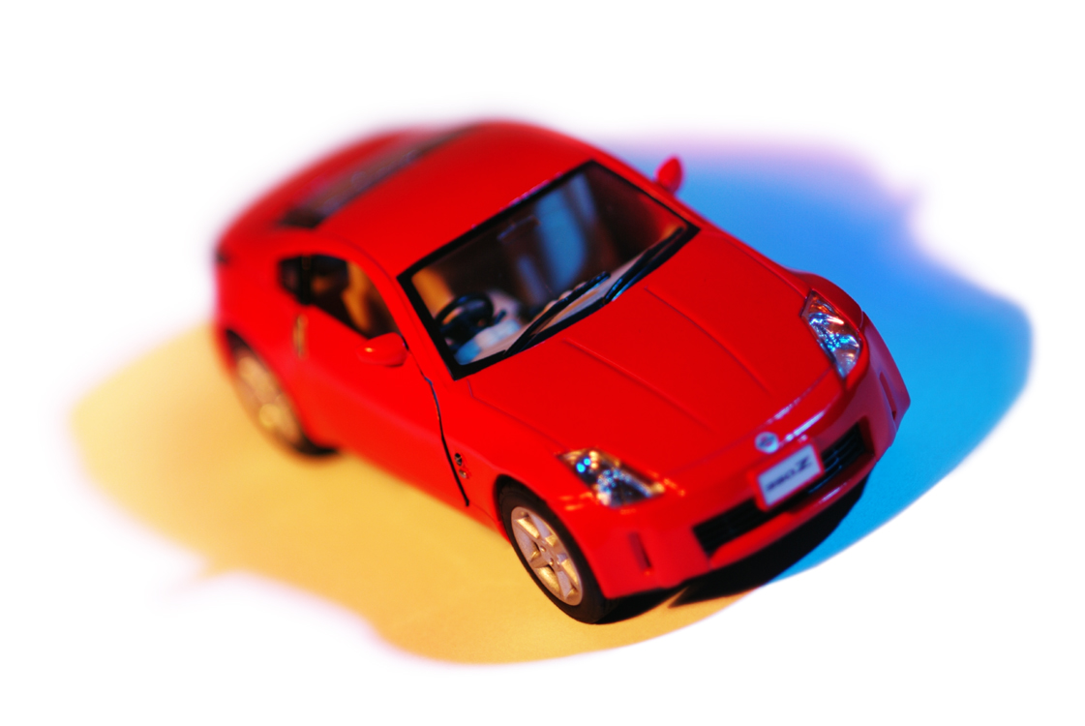
Car

Slide 8

Toothbrush

Slide 9
Shoes

Slide 10

Book

Slide 11
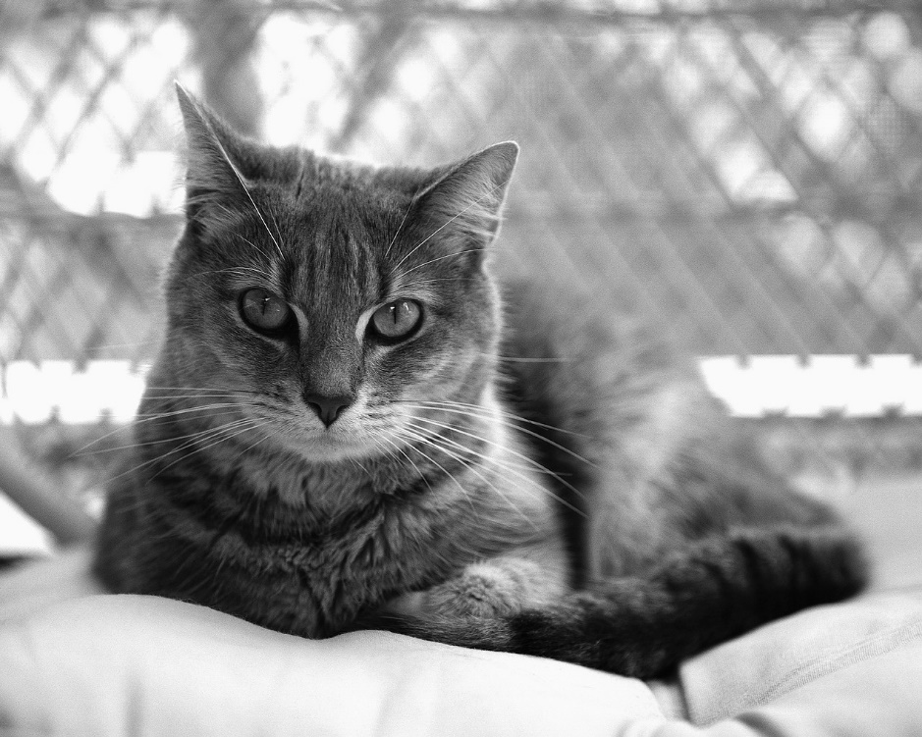
Cat

