Slide 1
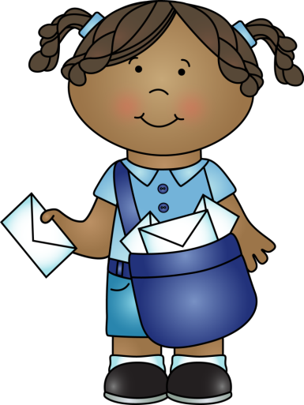
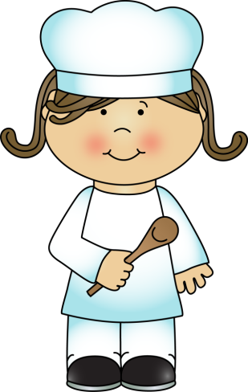
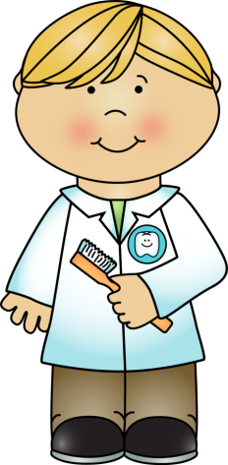

Guess My Job

Slide 2
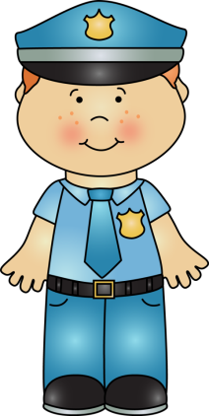
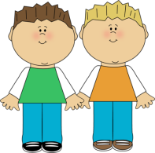
I do so many things that it’s amazing. I can help you in many ways. Above all, I protect you. I can direct traffic. I can find the bad guys and arrest them. I wear a blue uniform and I drive a black and white car. I am a ________________.
police officer

Slide 3

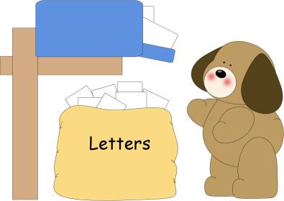
I come by your house 5 or 6 days a week. I bring you letters, magazines, and packages. I usually put these things in a special box. I drive a little car or I ride a motorcycle. Sometimes I even walk. I am a _________ or a _________.
postman
mail carrier

Slide 4
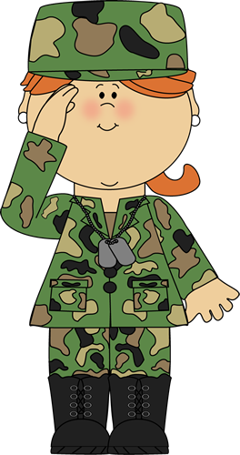
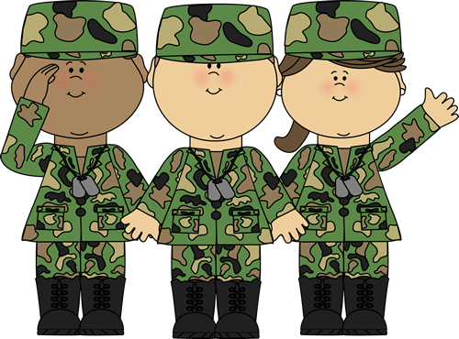
We are in the army. We are wearing our camouflage uniforms so that the enemy cannot see us. Our job is to protect our country. Sometimes we travel in helicopters. We always obey orders.
We are _________.
soldiers

Slide 5

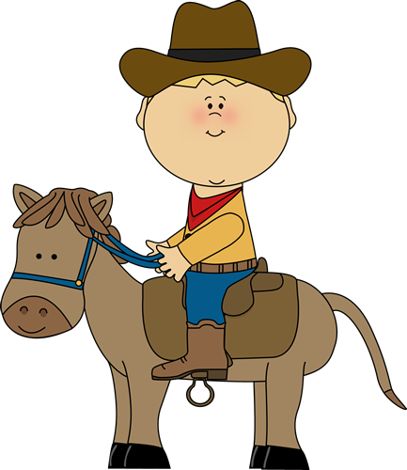
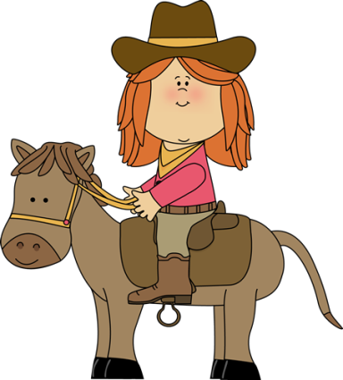
We live in the west. We ride horses. We take care of cattle and often take them to new pastures. We herd them too. We also tame horses. We live on a ranch. We are ___________ and ____________.
cowboys
cowgirls

Slide 6
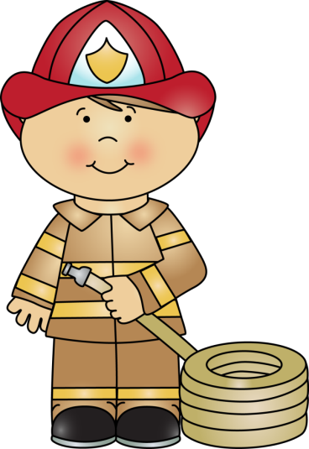
My job is very important. I protect and save your home. I wear a special uniform- usually black. I ride in a big red truck. I spend a lot of time practicing to do my job well, and I am always ready to help you. I am a ____________.
fireman

Slide 7
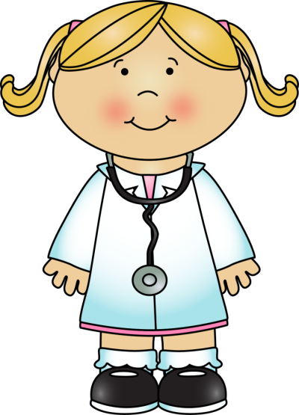
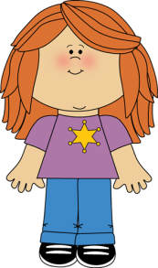
I take care of everyone from babies to old people. I give you advice about what to eat. I also give you shots and pills. Sometimes I take your temperature. I am just like a vet except that I take care of people. I am a ___________.
doctor

Slide 8


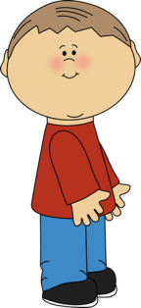
Scared. This is how most people feel when they visit me. I help keep your teeth healthy. I clean them and I fill your cavities. I am a _____________.
dentist
I just visited my dentist. He gave me a new toothbrush. And I lost another tooth today- so the Tooth Fairy is going to come tonight- take my tooth- and leave me some money. Yipee!

Slide 9
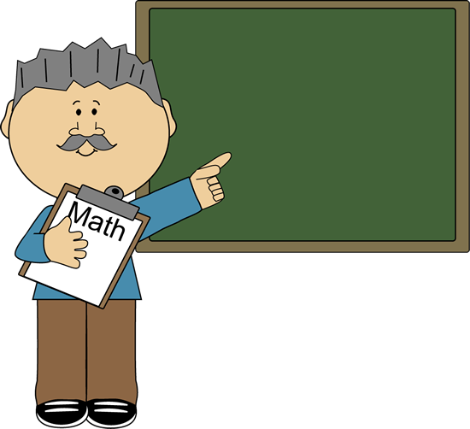

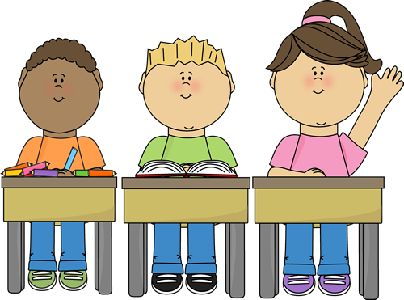
I can be a man or a woman. I work with children and adults. I work in a special building. I teach the whole world to read and write and also teach them lots of interesting things. I am a _____________.
teacher
Good Morning!
Today is September 10th
^{Welcome.}
Good morning class. Today is Monday, September 10th.

Slide 10

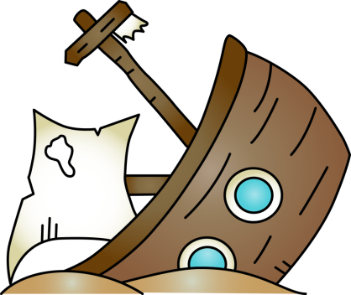
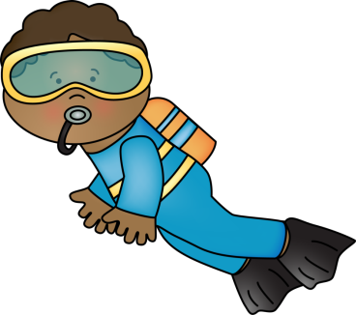







My job is underwater. I work in seas and oceans, and sometimes rivers. I wear special clothes to keep warm and protect myself. I also carry oxygen bottles on my back. I wear a mask and flippers too. Sometimes I look for treasures, and sometimes I just look for missing objects. I am a _________.
diver

Slide 11
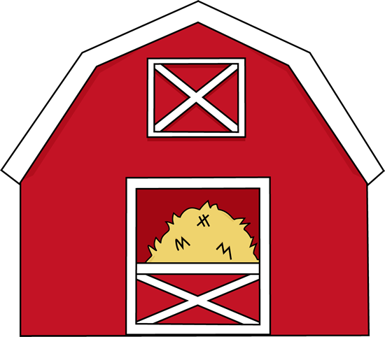
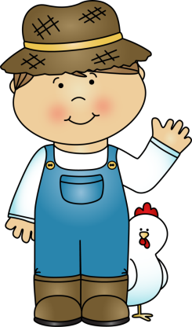
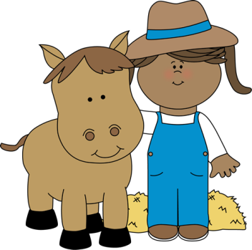
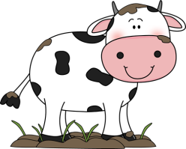

We work with animals. But we’re not vets. We also grow crops like corn and wheat. We provide you with all the food you eat. We live in the country. We have a house and a barn and lots of land.
We are __________.
farmers

Slide 12


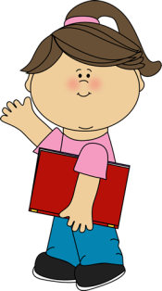
I work in a special building that is always quiet. The building is filled with shelves of books, computers, magazines, and DVDs. You can borrow all these things. I am a __________.
librarian

Slide 13

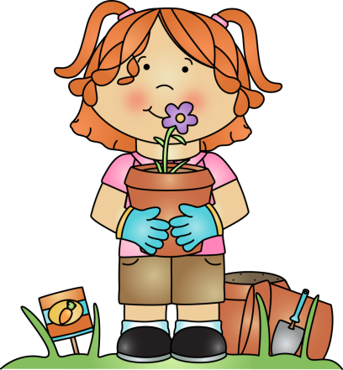
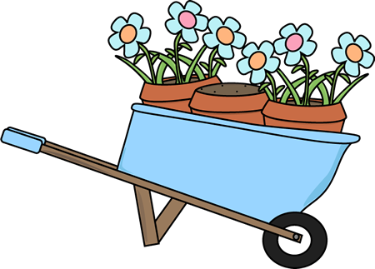



I work outside. I plant flowers, bushes, and trees. I cut the grass. I make your garden beautiful. I like the fresh air and listening to the birds. I am a __________.
gardener

Slide 14
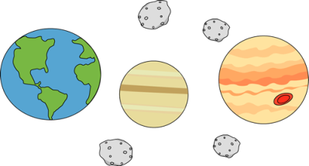
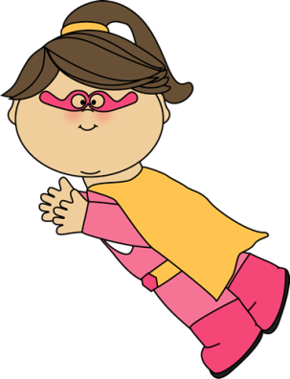
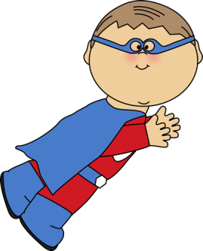
We can do amazing things. We can fly like a bird. We can save people from harm. We are stronger than real people. We wear capes and special glasses, so we have X-Ray vision just like Superman. We are _________ ___________.
super
heroes

Slide 15
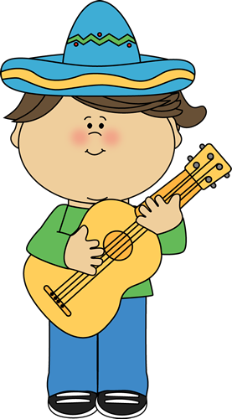
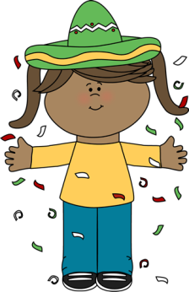

Hola! Or hi! We wear sombreros. We play the guitar and the maracas. Our music is called mariachi. We are __________
musicians

Slide 16





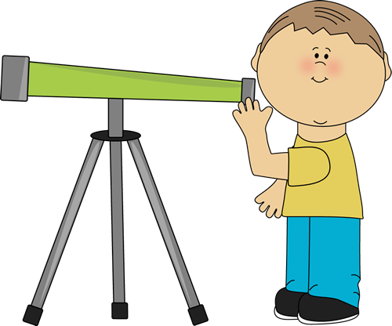
I love using a telescope and gazing at the stars and planets in the night sky. One day I hope to discover a new planet. I am an ___________.
astronomer

Slide 17
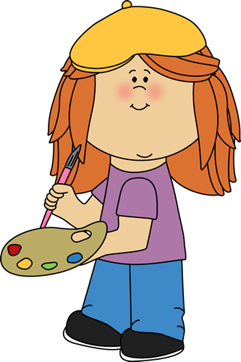
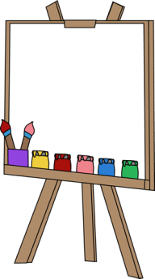

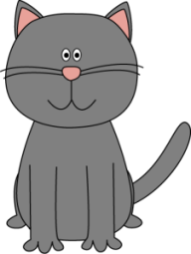
I love to paint pictures. I am crazy about working with paints and brushes. Today I am painting a picture of my cat Whiskers. I hope to become a famous __________ one day.
artist

Slide 18
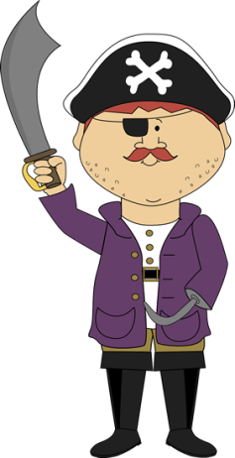
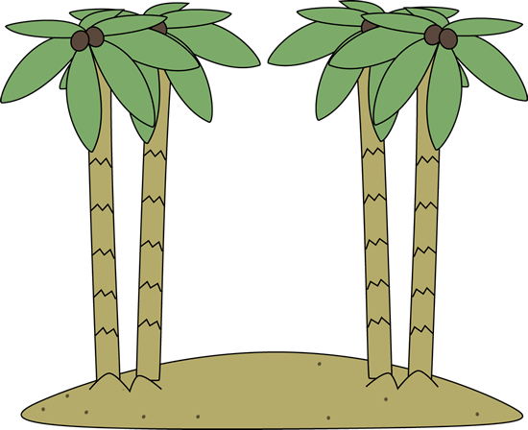
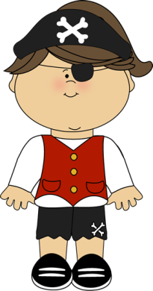
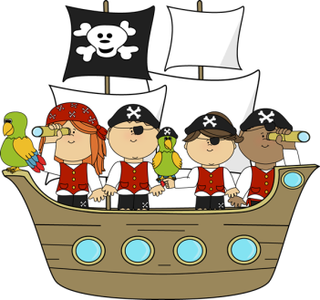

Ahoy matey! We are searching for buried treasure on that island over there. Our favorite parrot showed us the map. The captain wears an eye patch. He is a _____.
pirate

Slide 19
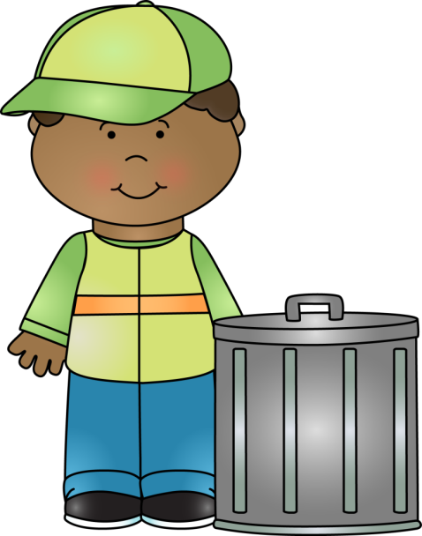

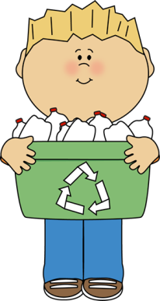

My job is very important. I travel around in a special truck. My truck smells- it’s true. Everyone is recycling these days, which is great because that means that things are being reused instead of being thrown away.
I am a ___________.
garbage man

Slide 20
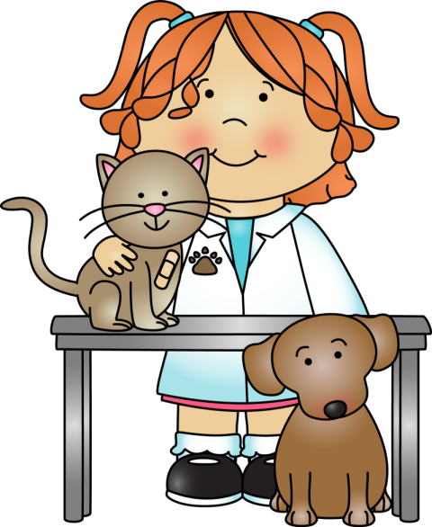
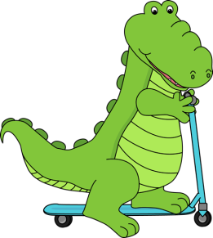
I love animals. I love them so much that they are my patients. I make sure they stay healthy. I cure them when they are sick. I am a _______ for short and a ___________ for long.
vet
veterinarian

Slide 21



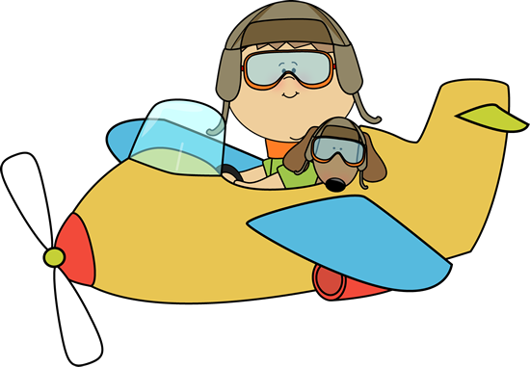

I fly in the sky like a bird. I travel all around the world. I am a ________.
pilot

Slide 22
Scared. This is how most people feel when they visit me. I help keep your teeth healthy. I clean them and I fill your cavities. I am a _____________.
dentist
I just visited my dentist. He gave me a new toothbrush. And I lost another tooth today- so the Tooth Fairy is going to come tonight- take my tooth- and leave me some money. Yipee!

Slide 23
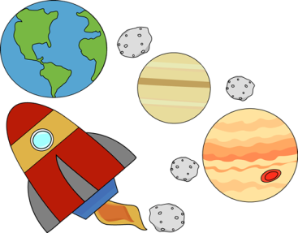
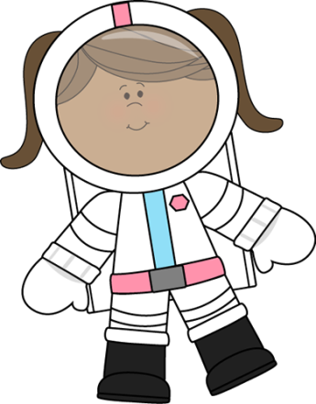
I am adventurous. I travel to outer space in a rocket ship. I am an ____________.
astronaut

Slide 24

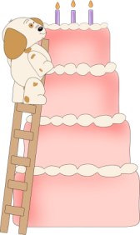





I like to make sweet things. I bake these things in an oven. I make special ones for a birthday.
I am a ________.
baker

Slide 25
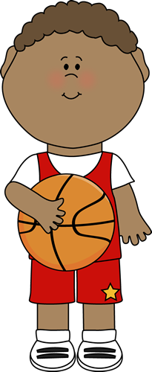

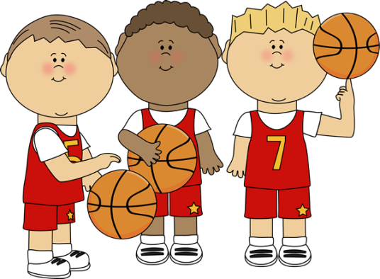
I am very tall. I play a sport that has a big orange ball and a net. I run a lot. I am a __________.
basketball player

Slide 26
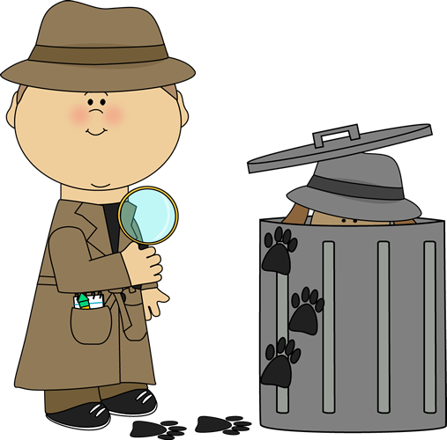
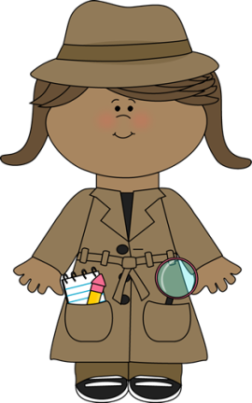
We look for missing dogs, cats, and missing people. We search for clues. The clues will help us solve the mystery. We are ___________.
detectives

Slide 27





What would you do without me? I solve all your kitchen and bathroom problems. I have a big tool kit. Water is my friend and sometimes your enemy. I am a ___________.
plumber

Slide 28

The End

