Slide 1
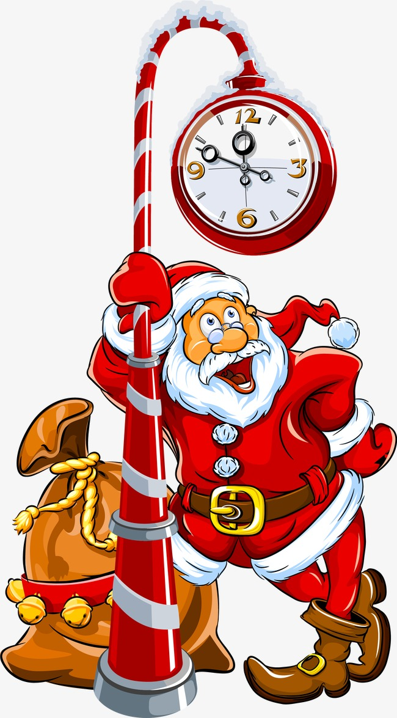
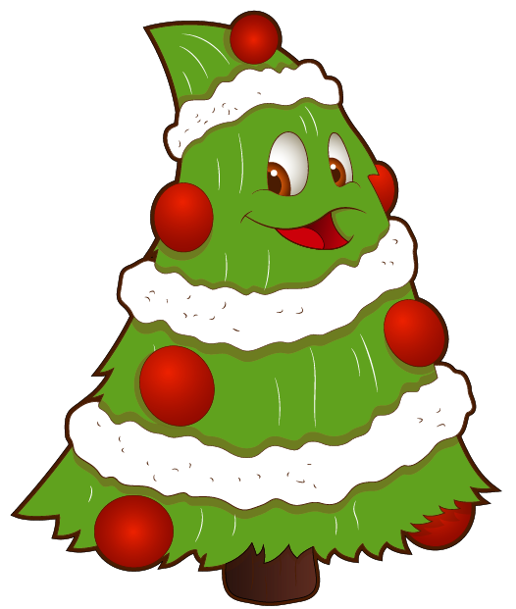
XMAS
GAME
Let’s play.

Slide 2
It’s…
GREAT
Rudolph
Santa Claus
Jesus

Slide 3
It’s a …
GREAT
Xmas tree
Xmas wreath
Xmas gift

Slide 4
They are...
GREAT
candles
angels
bells

Slide 5
They are…
GREAT
ornaments
gifts
stars

Slide 6
It’s...
GREAT
Santa’s train
Santa’s car
Santa’s sleigh

Slide 7
They are...
GREAT
candles
gifts
bells

Slide 8
It’s...
GREAT
pudding
holy
candy

Slide 9
It’s an …
GREAT
engel
elf
angel

Slide 10
They are ...
GREAT
stockings
ornaments
gifts

Slide 11
It’s a…
GREAT
sleigh
reindeer
snowman

Slide 12
They are...
GREAT
elves
reindeer
gifts

Slide 13
It’s an…
GREAT
alf
angel
elf

Slide 14
It’s a ...
GREAT
fireplace
tree
present

Slide 15
It’s a ...
GREAT
gift
wreath
bell

