Slide 1
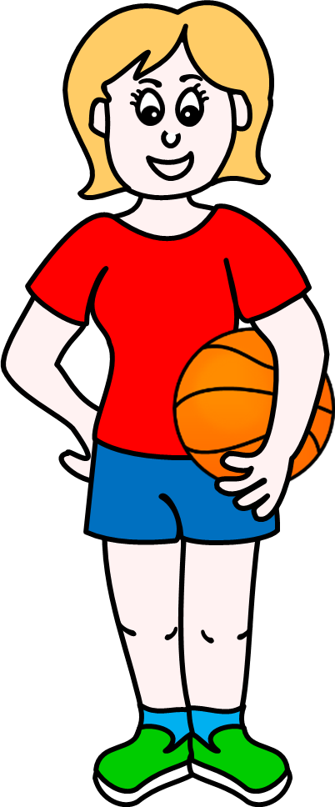

Slide 2
eye
ear
great
head
hair
mouth
It’s an ear.
neck

Slide 3
hand
arm
great
shoulder
waist
It’s an
elbow.
elbow
finger

Slide 4
ankle
knee
great
leg
foot
chest
It’s a leg.
toe

Slide 5
ear
head
great
face
nose
eye
It’s a mouth.
mouth

Slide 6
head
nose
great
ear
hair
neck
It’s hair.
eye

Slide 7
foot
leg
great
thigh
belly
knee
It’s a foot.
belly

Slide 8
hand
wrist
great
arm
palm
toe
It’s a finger.
finger

Slide 9
head
shoulder
great
neck
chest
mouth
It’s a neck.
face

Slide 10
chest
back
great
arm
waist
It’s a
shoulder.
shoulder
hand

Slide 11
foot
ankle
great
leg
thigh
It’s an
ankle.
knee
bottom

Slide 12
eye
ear
great
head
nose
mouth
It’s a nose.
neck

Slide 13
arm
elbow
great
shoulder
waist
hand
It’s a hand.
finger

Slide 14
ankle
leg
great
knee
foot
chest
It’s a knee.
toe

Slide 15
chest
back
great
belly
waist
thigh
It’s a back.
shoulder

Slide 16
eye
nose
great
ear
hair
neck
It’s a head.
head

Slide 17
ear
eye
great
face
nose
hair
It’s an eye.
cheek

Slide 18
face
neck
great
shoulder
chest
It’s a
stomach.
stomach
leg

Slide 19
hand
arm
great
neck
elbow
finger
It’s an arm.
wrist

Slide 20
bottom
back
great
arm
chest
shoulder
It’s a chest.
hand

Slide 21
hand
ankle
great
arm
thigh
knee
It’s a wrist.
wrist

