Slide 1
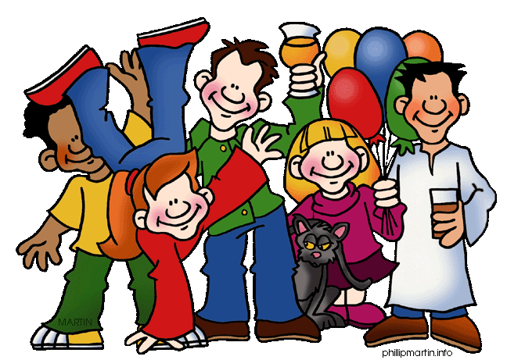
Prepositions of place

Slide 2
on
A dog is ……… the box.

Slide 3
under
A dog is ………… the hat.

Slide 4
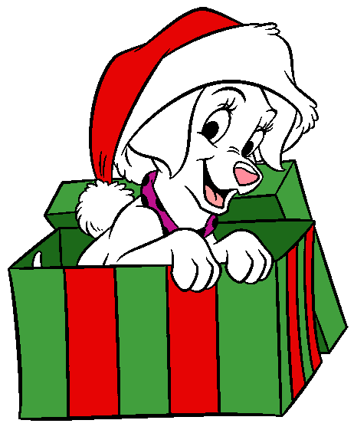
in
A dog is ……… the box.

Slide 5
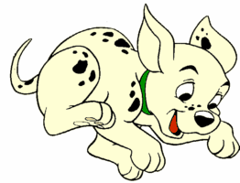
over
A dog is ……… the box.

Slide 6
in front of
A dog is …………….. the present.

Slide 7
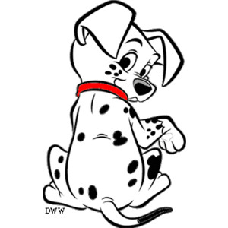
between
A dog is ……………. the boxes.

Slide 8
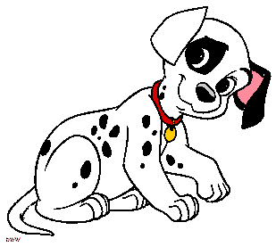
behind
A dog is …………. the present.

Slide 9
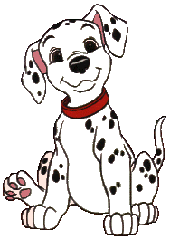
among
A dog is …………… the boxes.

Slide 10
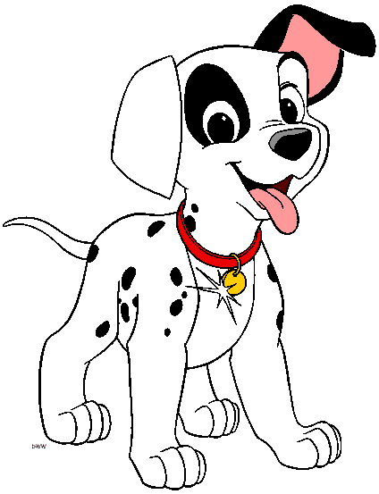
next to
A dog is …………… the ball.

Slide 11
on
over
among
under
in front of
between
in
behind
next to

Slide 12
Now…
Let’s play and practice!

Slide 13
behind
A boy is ……… the books.
under
over
behind

Slide 14
A cat is ……… the box.
in
behind
in
next to

Slide 15
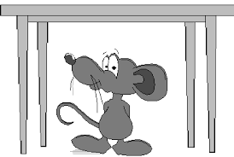
A mouse is ……… the table.
under
among
under
over

Slide 16
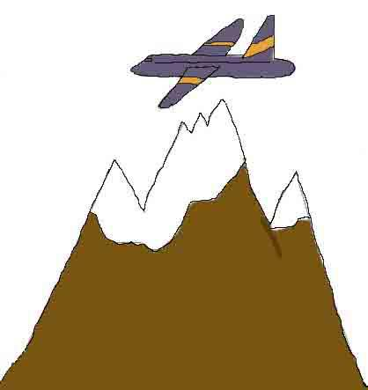
over
A plane is ……… the mountain.
over
between
on

Slide 17
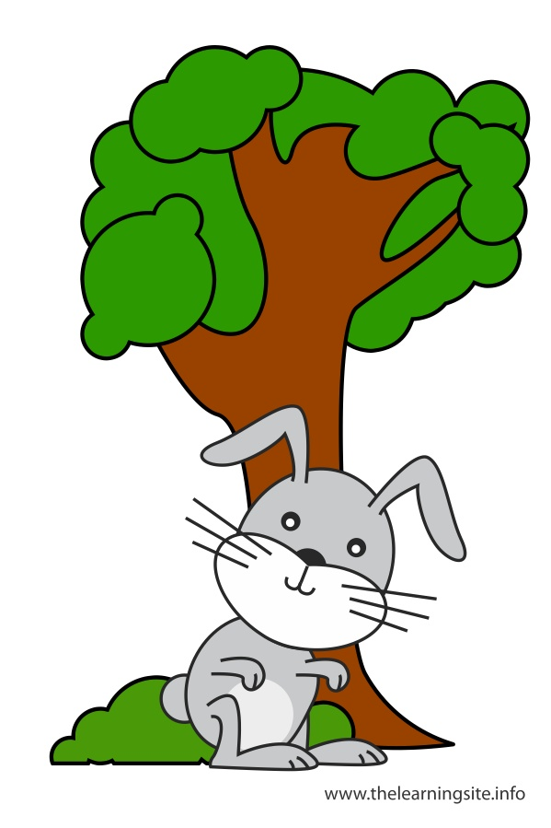
in front of
A rabbit is …………… the tree.
in front of
next to
behind

Slide 18
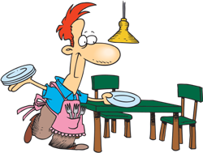
next to
A man is ………… the table.
among
between
next to

Slide 19
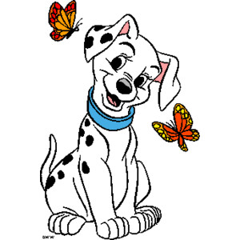
A dog is ……….. the butterflies.
between
between
in front of
over

Slide 20
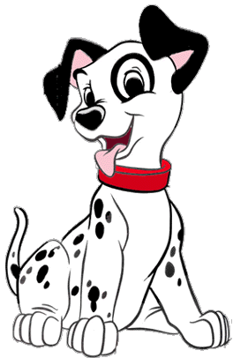
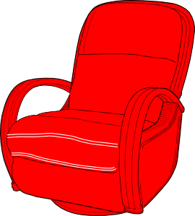
A dog is ……. the armchair.
on
over
on
next to

Slide 21
A witch is ……….. the pumpkins.
among
among
over
next to

Slide 22
on
over
among
under
in front of
between
in
behind
next to

Slide 23
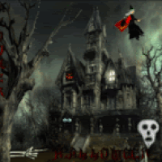
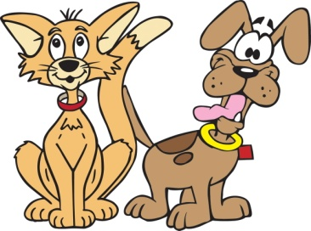
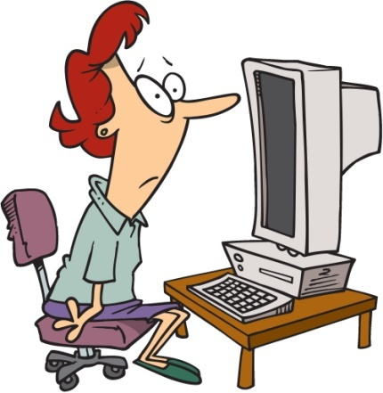
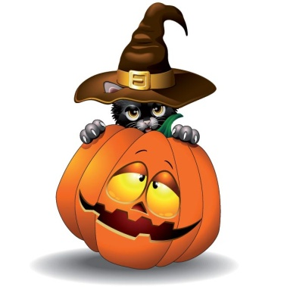
behind
A cat is ……………… the pumpkin.
A dog is ……………… the cat.
A witch is ……………… the house.
A woman is ………………. the computer.
next to
over
in front of

Slide 24
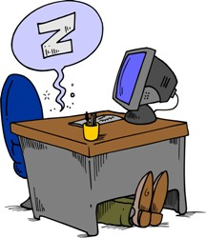
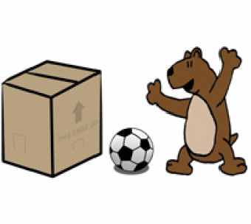
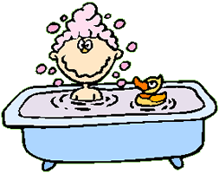
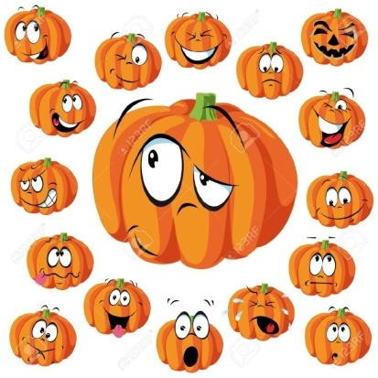
among
1. A big pumpkin is ……………. the small pumpkins.
2. A dog is ………………. the armchair.
3. A man is ……………….. the desk.
4. A ball is ……………. the box and bear.
5. A kid is ………………. the bath.
on
under
between
in

Slide 25
on
over
among
under
in front of
between
in
behind
next to

