Slide 1
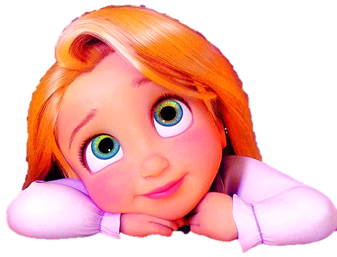
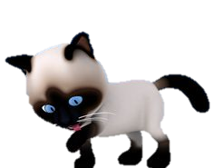
SECOND CONDITIONAL

Slide 2
1/15
If I were a doctor…
I would help people
stay healthy.
Look at the picture and complete the sentence

Slide 3
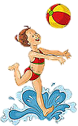
2/15
If I were at the beach…
I would play with
a beach ball.
Look at the picture and complete the sentence

Slide 4
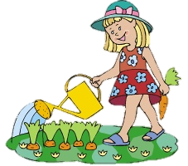
3/15
If I were a gardener…
I would water
the plants.
Look at the picture and complete the sentence

Slide 5
4/15
If I were in Paris…
I would see
the Eiffel Tower.
Look at the picture and complete the sentence

Slide 6
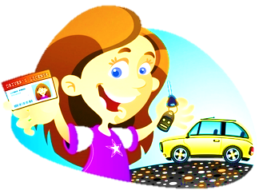
5/15
If I had a driver’s license…
I would drive a car.
Look at the picture and complete the sentence

Slide 7
6/15
If I had a cat…
I would feed it.
Look at the picture and complete the sentence

Slide 8
7/15
If I had a dog …
I would walk it.
Look at the picture and complete the sentence

Slide 9
8/15
If I were an athlete …
I would win
a gold medal.
Look at the picture and complete the sentence

Slide 10
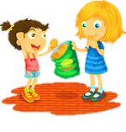
9/15
If I had some snacks …
I would share them
with my friends.
Look at the picture and complete the sentence

Slide 11
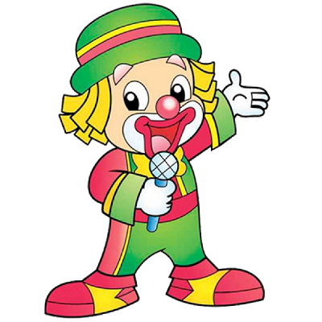
10/15
If I were a clown…
I would make
people laugh.
Look at the picture and complete the sentence

Slide 12
11/15
If I were a painter…
I would paint
the walls green.
Look at the picture and complete the sentence

Slide 13
12/15
If I were a chef…
I would cook
delicious cakes.
Look at the picture and complete the sentence

Slide 14
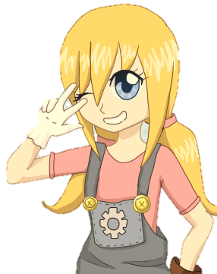
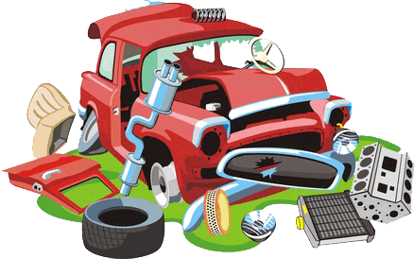
13/15
If I were a mechanic…
I would repair
damaged cars.
Look at the picture and complete the sentence

Slide 15
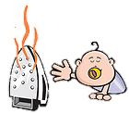
14/15
If I were a superhero…
I would save
people in danger.
Look at the picture and complete the sentence

Slide 16
15/15
If I were an air stewardess…
I would travel
around te world.
Look at the picture and complete the sentence

