Slide 1
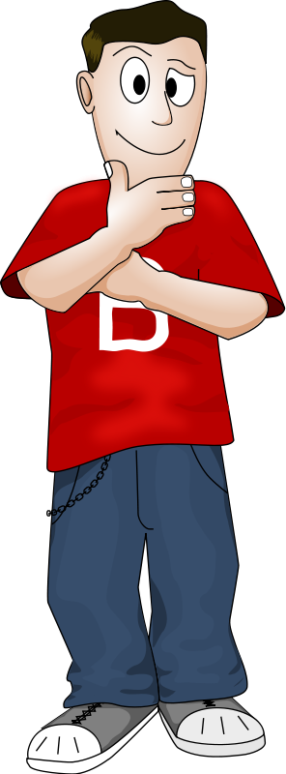
SECOND CONDITIONAL-TYPE II
…
IF I WERE
AN ASTR0NAUT…

Slide 2
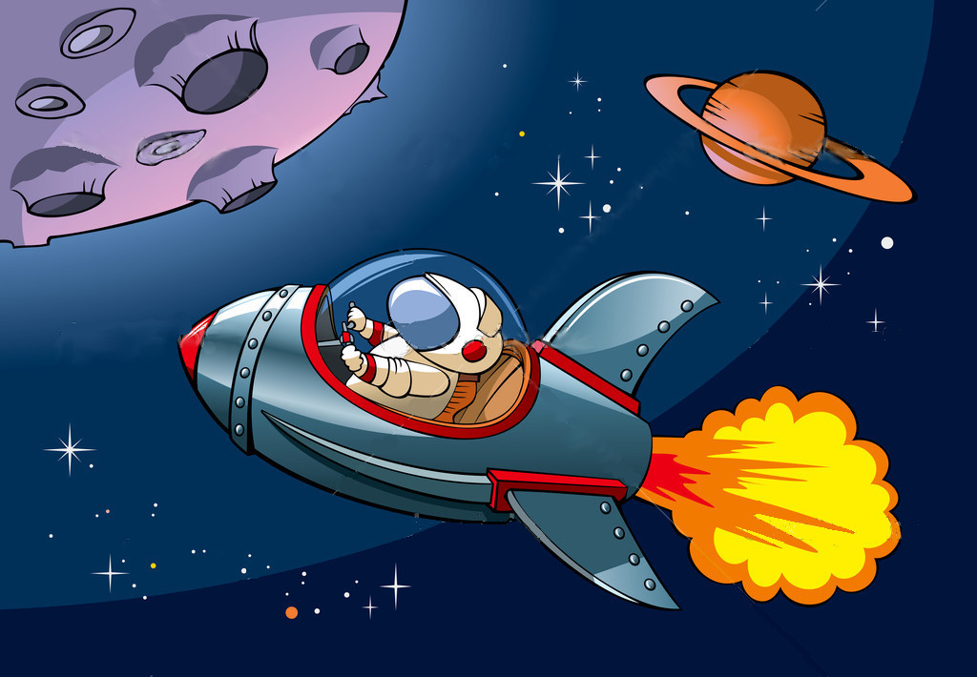
IF I WERE AN ASTRONAUT,
I WOULD TRAVEL IN A SPACESHIP.

Slide 3
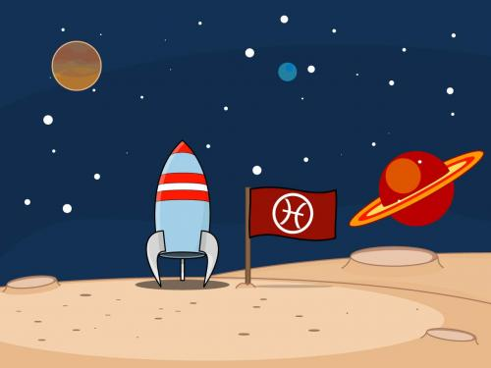
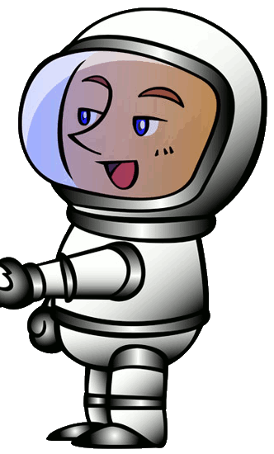
IF I TRAVELLED IN A SPACESHIP, I WOULD GO TO MARS.

Slide 4
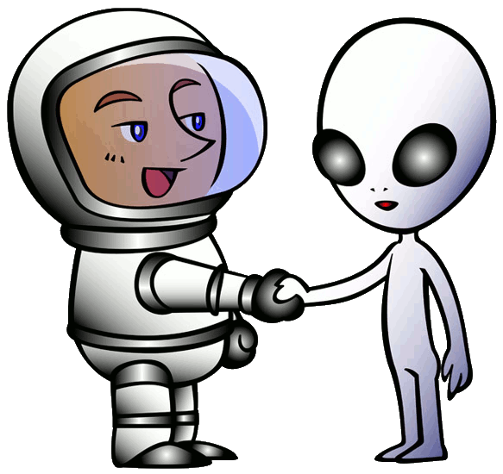
IF I WENT TO MARS,
I WOULD MEET A MARTIAN.
Nice to meet you!

Slide 5
IF I MET A MARTIAN,
I WOULDN’T UNDERSTAND HIM.
?
IfI aveed

Slide 6
IF I DIDN’T UNDERSTAND HIM,
I WOULD COME BACK TO THE EARTH.

Slide 7
What would you do
if you were a teacher?

Slide 8
What would you do
if you were a SCIENTIST?

Slide 9
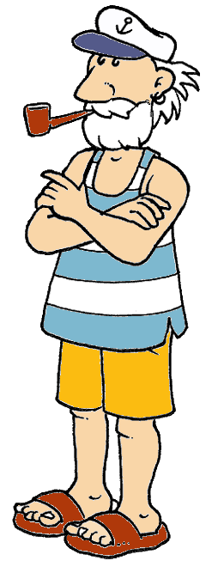
What would you do
if you were a SAILOR?

Slide 10
What would you do if you were rich?

Slide 11
“NOT WHAT WE HAVE BUT WHAT WE ENJOY, CONSTITUTES OUR ABUNDANCE”
EPICURUS, Greek philosopher.

