Slide 1
Describing how people look

Slide 2
Match the words
tall old
young short
thin overweight

Slide 3
long hair short hair
blonde hair grey hair
wrinkles glasses
brown hair a beard
curly hair freckles
bald
He has…………. He is………….. He wears…………….

Slide 4
Spellings
short
grey
wrinkles
glasses
brown
beard
curly
freckles
bald

Slide 5
Activity-
Put the words on your flashcards in the correct order.
If you finish quickly write about your own hair and someone else's in the class.

Slide 6
Sentences
curly he hair has
is bald he
long blonde she hair has
short black he hair has
brown short has she hair
grey hair long she has

Slide 7
Answers
He has curly hair.
He is bald.
She has long blonde hair.
He has short black hair.
She has short brown hair.
She has long grey hair.

Slide 8
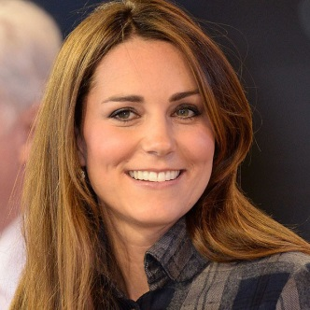
Describing hair
When describing hair we have to do it in this order-
Length long, short
Style curly, straight
Colour brown, grey
She has long blonde hair.
He has short curly black hair.
She has short straight brown hair.
She has long grey hair.

Slide 9
1 2 3 4 5 6
She has long blonde hair.

Slide 10
1 2 3 4 5 6
He has a beard.

Slide 11
1 2 3 4 5 6
He has freckles.

Slide 12
1 2 3 4 5 6
She has short straight brown hair.

Slide 13
Now write sentences in your book describing each of the people.
If you finish then write sentences describing 2 people you know.

