Slide 1
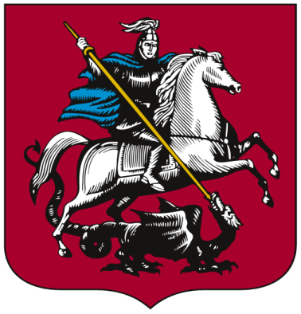
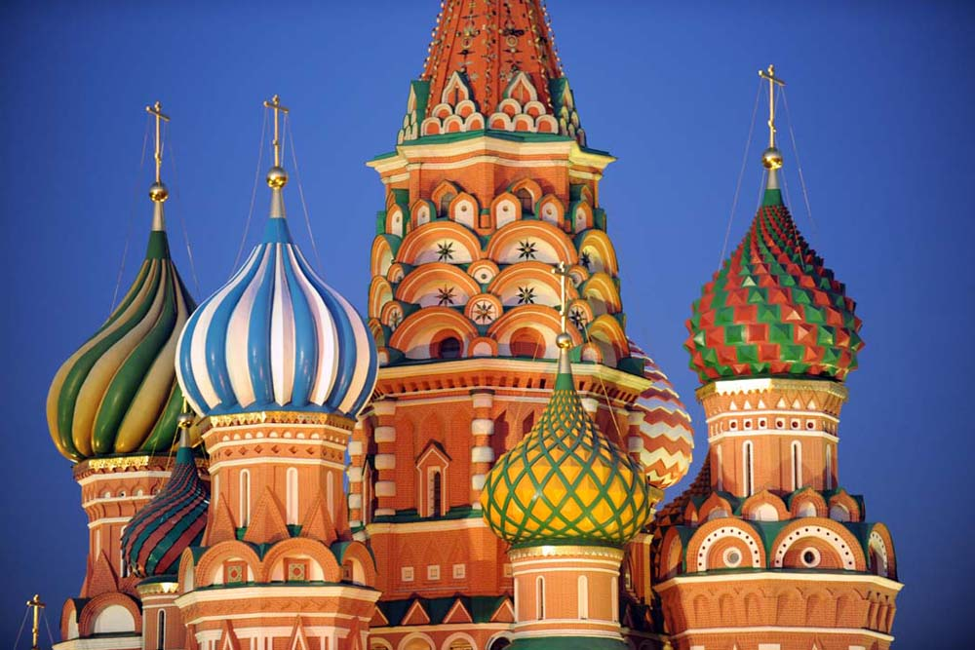
Moscow

Slide 2
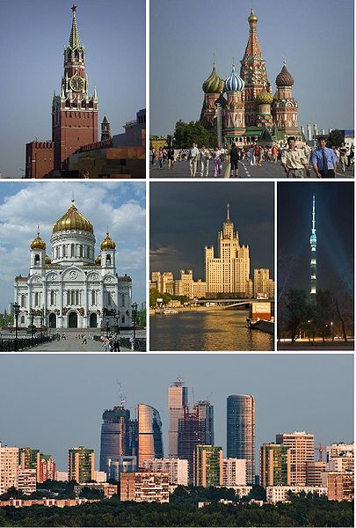
Moscow,
live - in city
Moscow is the capital and the largest city of Russia.
It is the largest metropolitan area in Europe.
It is also the seventh largest city in the world.
The population of Moscow is 10,524,400.

Slide 3
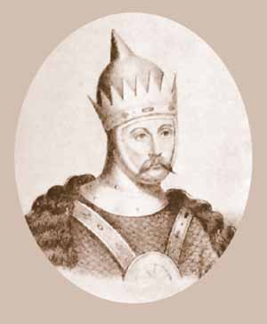
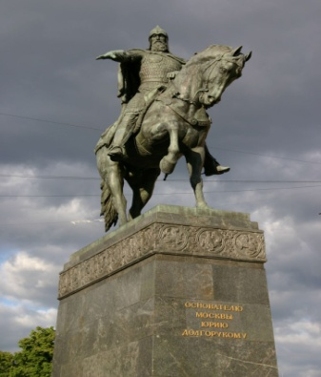
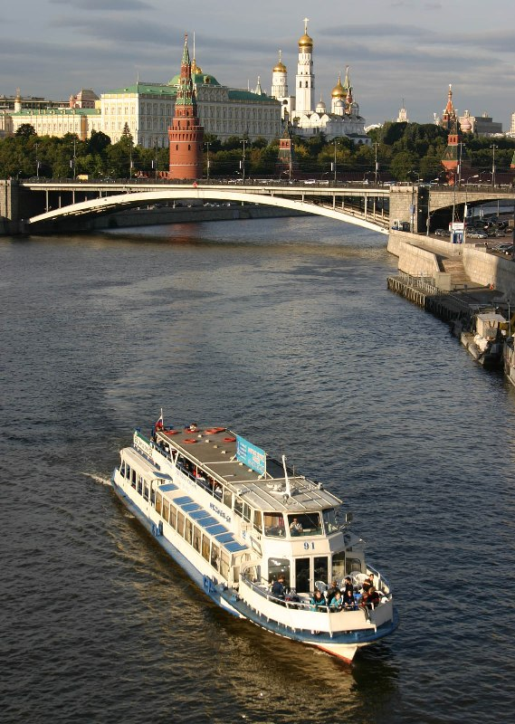
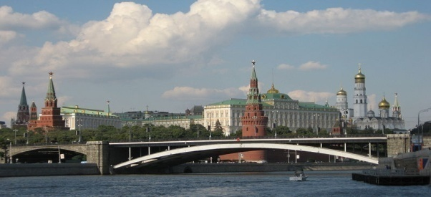
Moscow was founded in 1147 by Prince Yuri Dolgoruki on seven hills on both banks of the Moskva River.
Historically, it was the capital of
- the former Soviet Union,
- Tsardom of Russia and
- the Grand Duchy of Moscow.
Now Moscow is the site of the President of the Russian Federation.
The Russian parliament (the State Duma and the Federation Council) and the Government of Russia also sit in Moscow.
Became the capital of Russia | 1327
Capital moved to Saint Petersburg | 1712
Capital moved back to Moscow | 1918

Slide 4
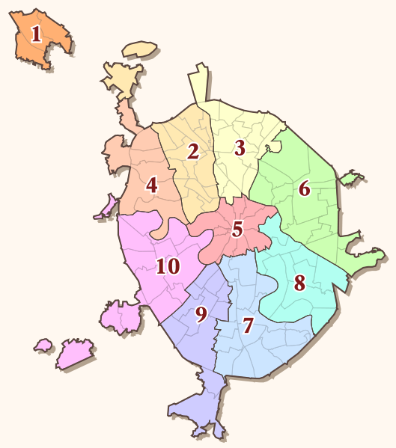
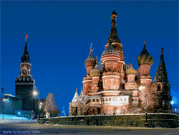
Administrative okrugs of Moscow:
1. City of Zelenograd,
2. Northern,
3. North-Eastern,
4. North-Western,
5. Central,
6. Eastern,
7. Southern,
8. South-Eastern,
9. South-Western,
10. Western
Moscow is governed by a city council and a mayor. The entire city of Moscow is headed by one mayor.
It is divided into ten administrative okrugs and 123 boroughs.
Nine of the ten administrative districts, except the City of Zelenograd (number 1 on the map), are located within City of Moscow main boundaries.

Slide 5
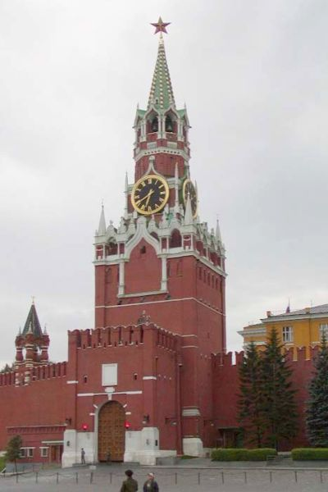
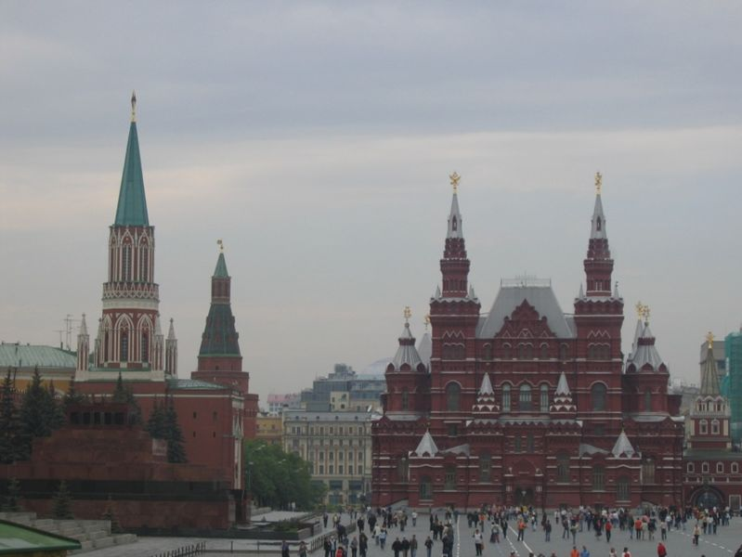
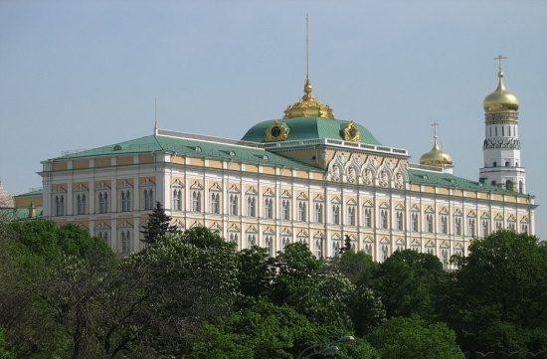
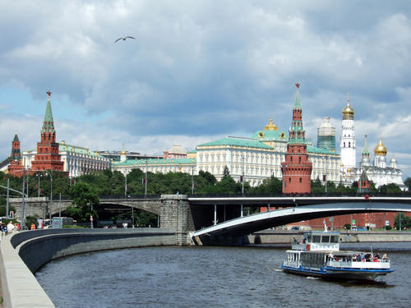
Moscow is Russia's largest city
and a leading
1. political,
2. cultural,
3. religious,
4. educational,
5. economic,
6. financial,
7. transportation
center of Russia and the world.
Government
Moscow is the seat of power for the Russian Federation.
At the centre of the city is the Moscow Kremlin , one of the World Heritage Sites in the city, which houses the home of the President of Russia as well as many of the facilities for the national government.

Slide 6
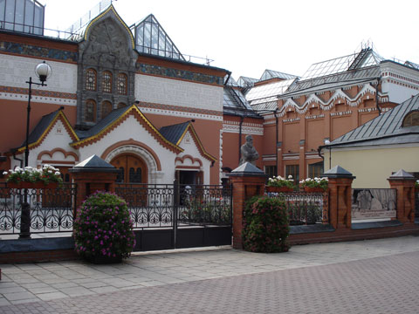
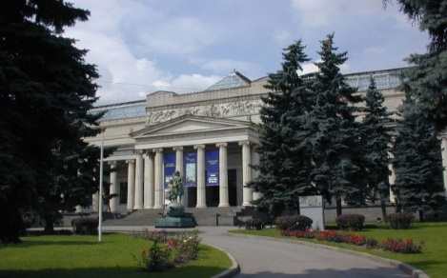
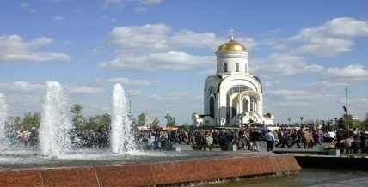
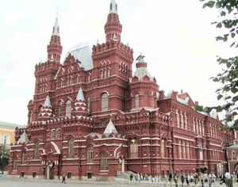
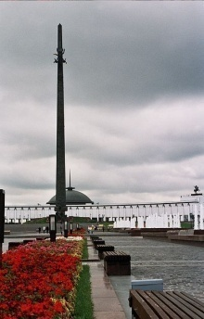
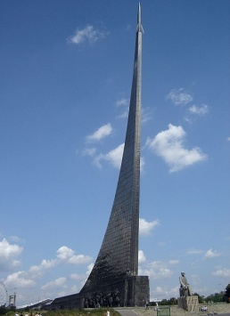
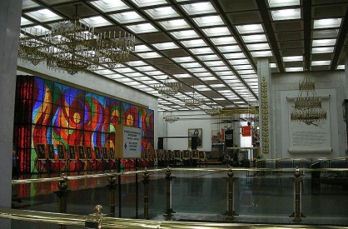
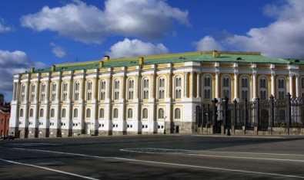
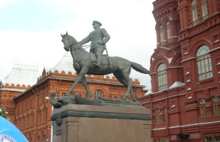
Moscow is home to many museums, galleries, and other institutions which are major tourist attractions as well as playing a research role.
Culture
The State Historical Museum of Russia is a museum of Russian history.
The Tretyakov Gallery houses the works of the classic Russian tradition.
The city also houses extensive art collections, primarily in the Pushkin Museum of Fine Arts,
the Moscow Museum of Modern Art, the Museum of Avant-Garde Mastery and in many others.
While the Museum of the Great Patriotic War at Poklonnaya Gora has an open display of military vehicles, aircraft, cannons, and the Central Museum building.
The other museums to visit are
-the Memorial Museum of Cosmonautics;
-the Kremlin Lenin's Mausoleum;
-the Museum of Arts and Crafts;
-the Museum of Early Russian Art;
-the Museum of Mayakovsky;
-the Museum of Moscow History;
-the Museum of Oriental Art;
-the Museum of Vysotsky;

Slide 7
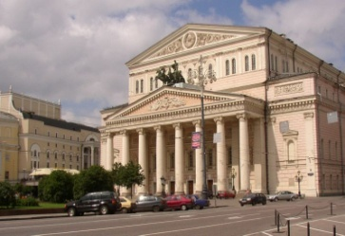
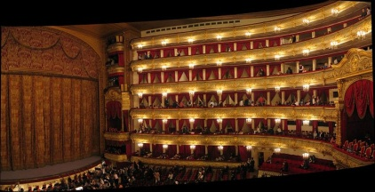
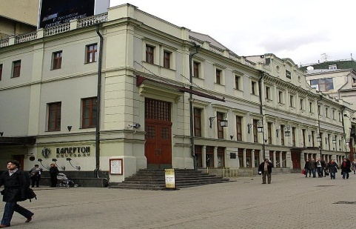
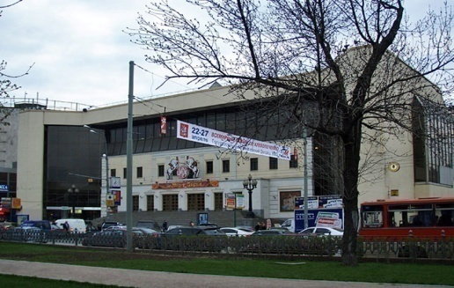
Moscow is also the heart of Russian performing arts, including ballet and film. There are ninety-three theatres, 132 cinemas and twenty-four concert-halls in Moscow. Among Moscow’s many theatres and ballet studios is the Bolshoi Theatre and the Malyi Theatre as well as the Vakhtangov Theatre and the Moscow Art Theatre. The repertories in a typical Moscow season are exhaustive, and modern interpretations of classic works, whether operatic or theatrical, are quite common.
There are also two large circuses in Moscow: Moscow State Circus and Moscow Circus on Tsvetnoy Boulevard named after Yuri Nikulin.
Soviet films are integral to film history and the Mosfilm studio was at the heart of many Soviet classic films as it is responsible for both artistic and mainstream productions.

Slide 8
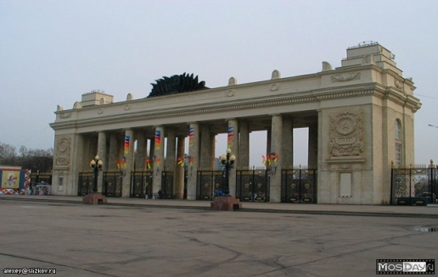
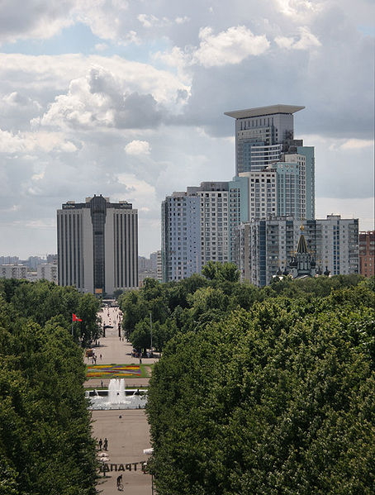
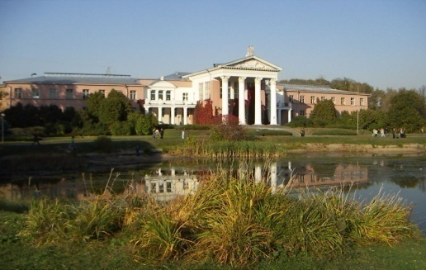
Moscow is a very green city
if compared to other cities of comparable size in Western Europe and America.
Many large parks and recreation areas
(96 parks,18 gardens and 4 botanical gardens) include Gorky Central Park, the forested Izmailovo and Sokolniki parks, and Ostankino Park, with its botanical gardens.
The Central Park of Culture and Rest, named after Maxim Gorky, was founded in 1928. The main part along the Moskva river contains estrades, children's attractions (including the Observation Wheel, water ponds with boats and water bicycles), dancing, tennis courts and other sports facilities.
It borders the Neskuchniy Garden, the oldest park in Moscow and a former Emperor's residence.
Izmaylovsky Park created in 1931 is one of the largest urban parks in the world along with
Sokolniki Park, named after the falcon hunting that took place there in the past.
Gorky Central Park
Sokolniki Park
Botanical Garden of
Academy of Sciences

Slide 9
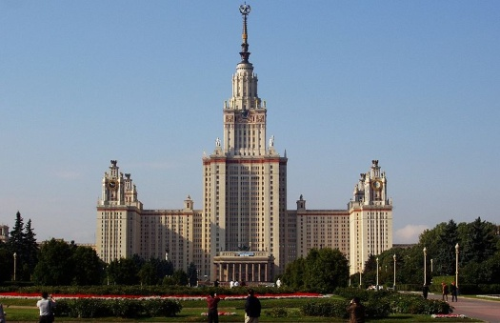
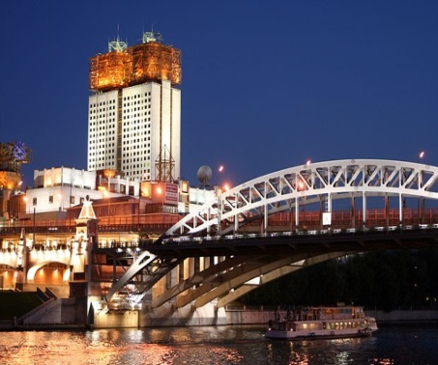
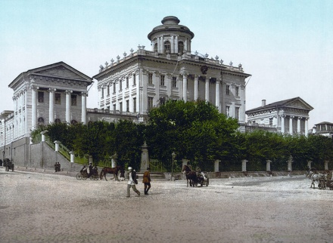
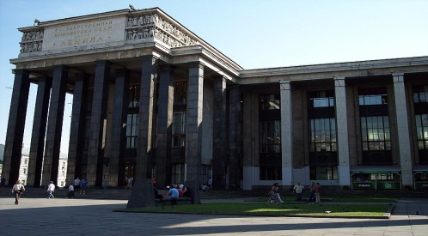
Education and science
It is home to many scientific and educational institutions, as well as numerous sport facilities.
There are 1696 high schools in Moscow, as well as 91 colleges.
Besides these, there are 222 institutions offering higher
education in Moscow, including 60 state universities and
the Lomonosov Moscow State University, which was founded in 1755.
Moscow State University at Sparrow Hills
There are 452 libraries in the city, including 168 for children.
The Russian State Library, Russia's national library, located in Moscow, is the largest library in Europe and the second largest in the world. It was founded in 1862.
the Russian
Academy of Sciences

Slide 10
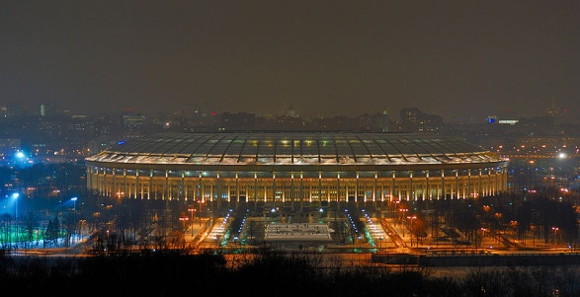
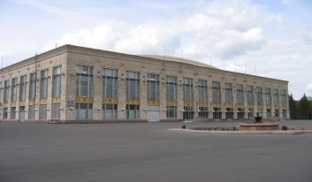
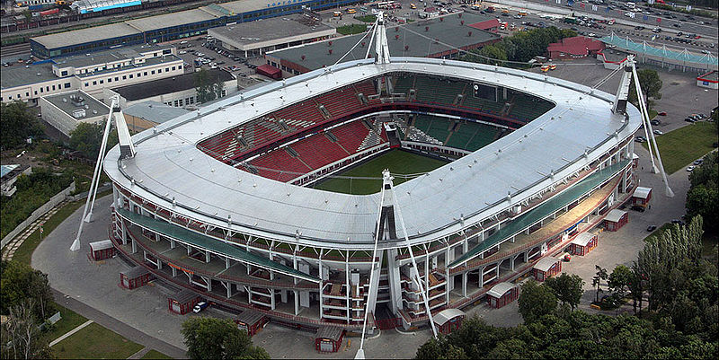
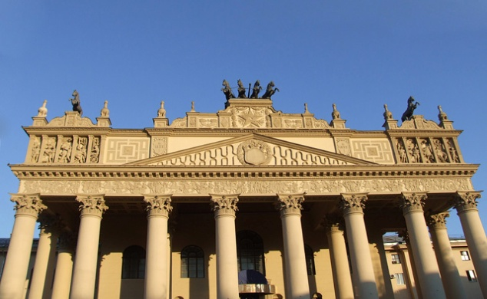
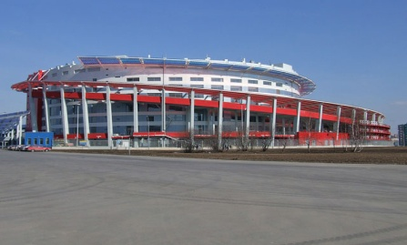
Sports
Moscow possesses a large number of various sport facilities.
Moscow is home to sixty-three stadia (besides eight football and eleven light athletics maneges), of which Luzhniki Stadium is the largest and the 4th biggest in Europe.
Forty other sport complexes are located within the city, including twenty-four with artificial ice. There are also seven horse racing tracks in Moscow, of which Central Moscow Hippodrome, founded in 1834, is the largest.
Luzhniki Stadium
Lokomotiv Sradium
Central Moscow Hippodrome
The Khodynka Arena

Slide 11
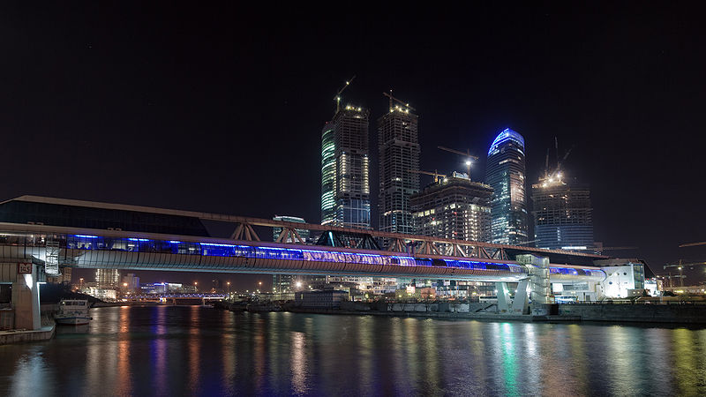
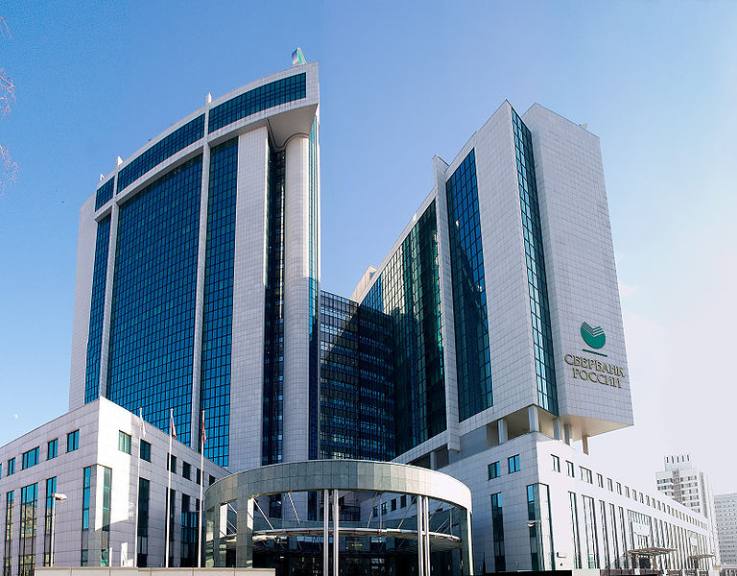
Economy and finances
Moscow is a major economic centre and is home to one of the largest numbers of billionaires in the world.
In 2008 Moscow was named the world's most expensive city.
However, in 2009, Moscow moved to third after Tokyo and Osaka came in first and second, respectively.
Moscow International
Business Centre
Sberbank Rossii
A significant portion of Russia's profits and development is concentrated in Moscow as many multi-national corporations have branches and offices in the city.

Slide 12
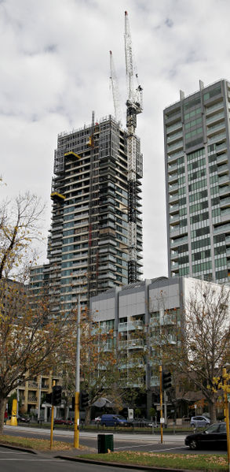
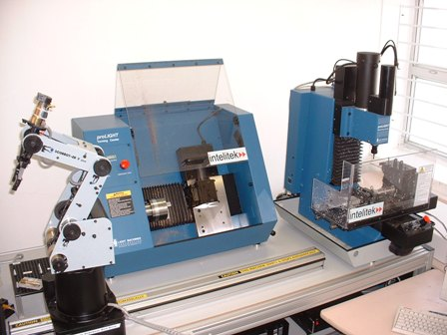
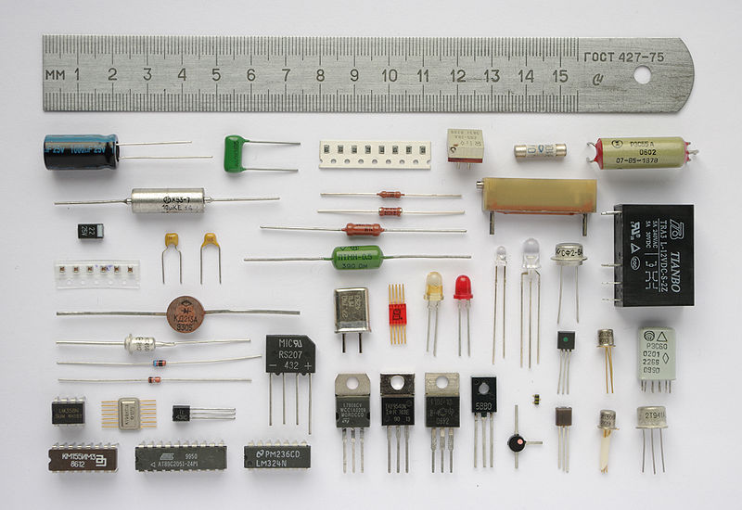
Industries
Moscow's major industries include machine building,
metalworking,
oil refining,
publishing,
filmmaking,
the manufacture of machine tools, precision instruments,
building materials,
automobiles, trucks, aircraft, chemicals, wood and
paper products, textiles, clothing, footwear, and soft drinks.

Slide 13
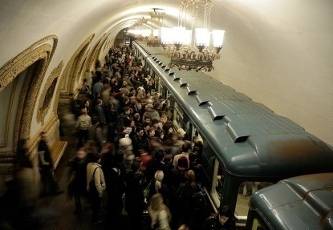
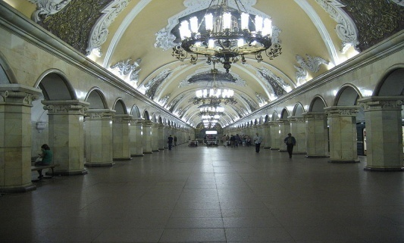
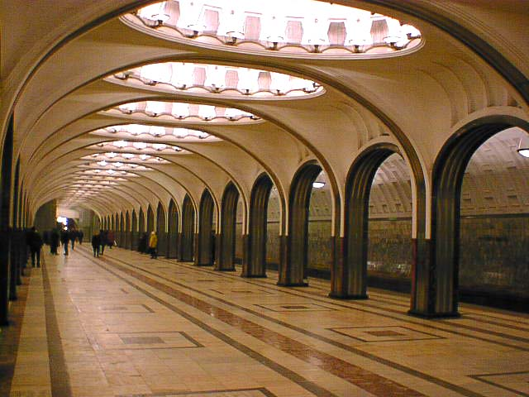
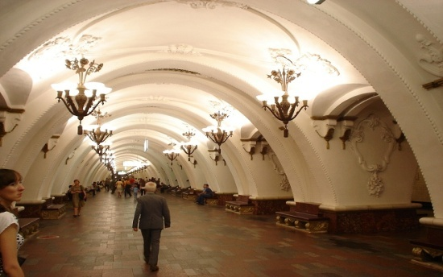
Transport
It possesses a complex transport system, that includes 3 international airports, 9 railroad terminals, and the world's second busiest (after Tokyo) metro system which is famous for its architecture and artwork. Its metro is the busiest single-operator subway in the world.
Metro
It was opened in 1935, it is well known for the ornate design of many of its stations, which contain outstanding examples of socialist realist art.
Komsomolskaya station
Mayakovskaya station
Arbatskaya station

Slide 14
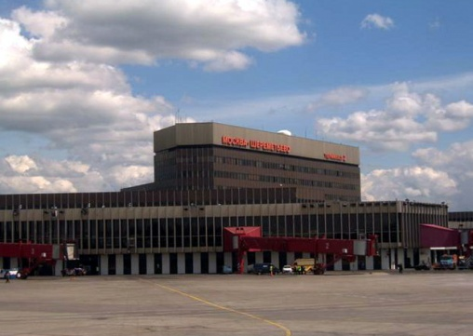
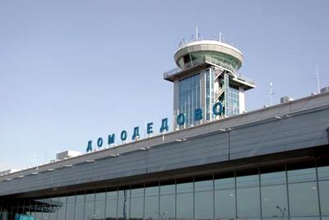
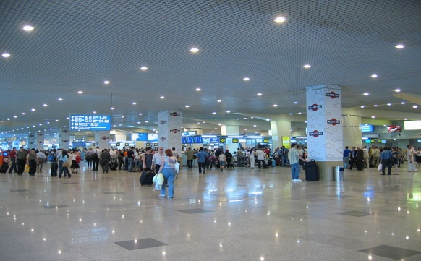
Air
There are five commercial airports serving Moscow:
Sheremetyevo International Airport,
Domodedovo International Airport,
Bykovo Airport,
Ostafyevo International Airport and
Vnukovo International Airport.
Sheremetyevo International Airport is the most common entry point for foreign passengers, handling sixty percent of all international flights.
Domodedovo International Airport is the leading airport in Russia in terms of passenger throughput, and is the primary gateway to long domestic and CIS destinations.
The three other airports particularly offer flights within Russia and to and from states from the former Soviet Union.

Slide 15
Moscow employs several train stations to serve the city.
Moscow's rail terminals are:
1. Belorussky Rail Terminal
2. Kazansky Rail Terminal
3. Kiyevsky Rail Terminal
4. Kursky Rail Terminal
5. Leningradsky Rail Terminal
6. Paveletsky Rail Terminal
7. Rizhsky Rail Terminal
8. Savyolovsky Rail Terminal
Komsomolskaya Square, known as Kalanchyovskaya before 1932, is one of the busiest squares in Moscow.
It is often referred to informally as Three Station Square thanks to three rail terminals situated there: Leningradsky, Yaroslavsky, and Kazansky.
Railway

Slide 16
Moscow is the port of five seas.
Water
The North River Terminal or Rechnoy Vokzal is one of two passenger terminals of river transport in Moscow.
It is also the main hub for long-range and intercity routes. It was built in 1937.
The other one is the South River Terminal.

Slide 17
1.What is Moscow?
2.When was Moscow founded?
3. What was Moscow historically the capital of? When?
4.What are the government sights of Moscow?
5.Prove that Moscow is the centre of performing art in Russia.
6.
7. What makes Moscow as a transport centre?
1.What is the population of Moscow?
2.Where is Moscow situated?
3.Who was Moscow founded by?
4.How many okrogs and boroughs does Moscow consists of? What are they?
5. What are the cultural sights of Moscow?
6. What makes Moscow as a sport centre?
7. Prove that Moscow is an economic and financial centre of Russia.

