Slide 1
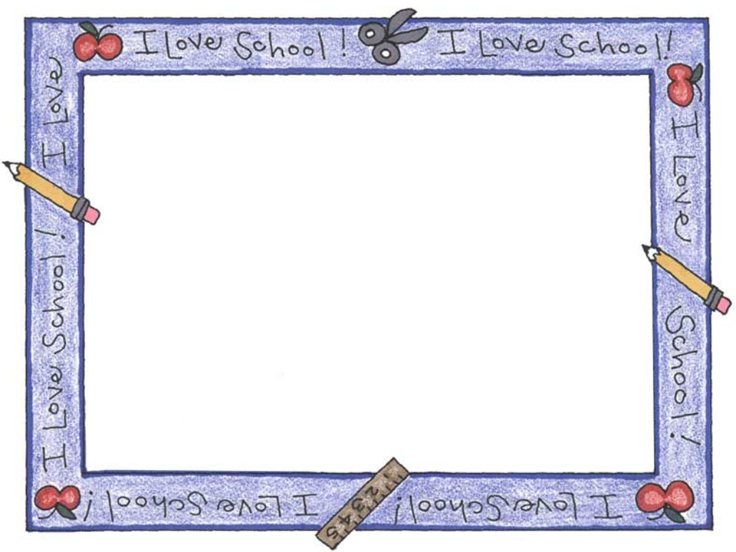
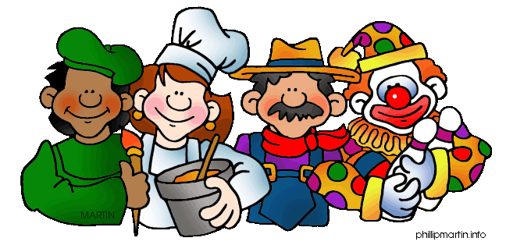
A Lesson About
JOBS

Slide 2
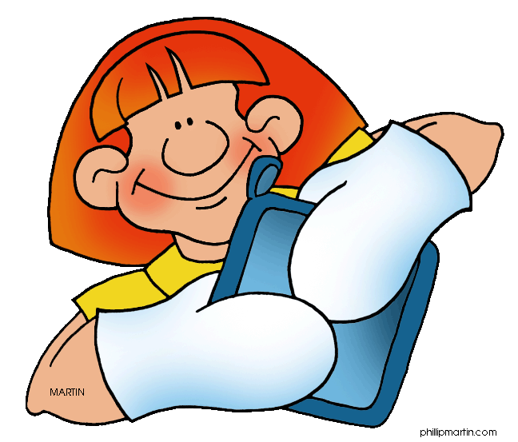
A person who makes bread, rolls and pastry.

Slide 3
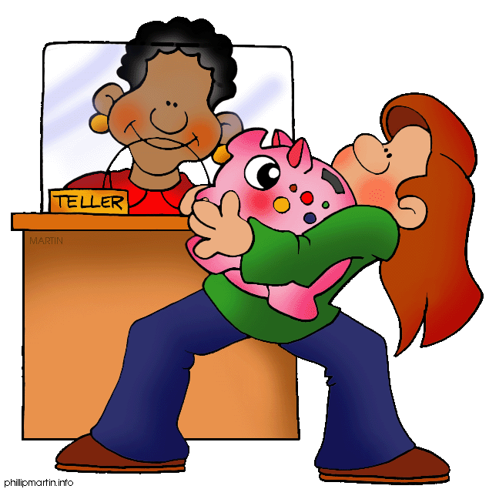
Someone who sells accounts and who works
with money.

Slide 4
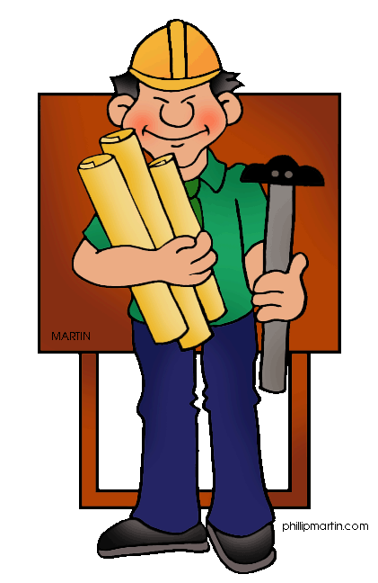
Someone who builds, creates or designs houses.

Slide 5
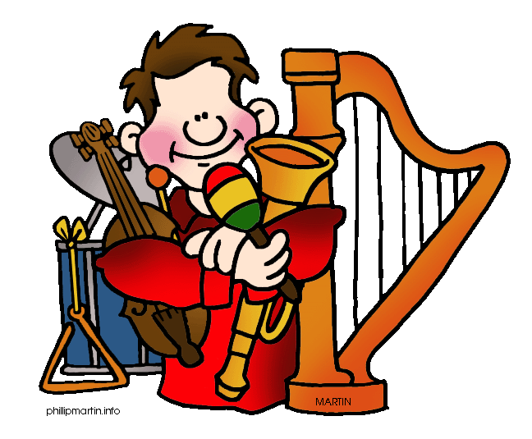
Someone who plays in an orchestra.

Slide 6
A man or woman who can cure illness professionally.

Slide 7
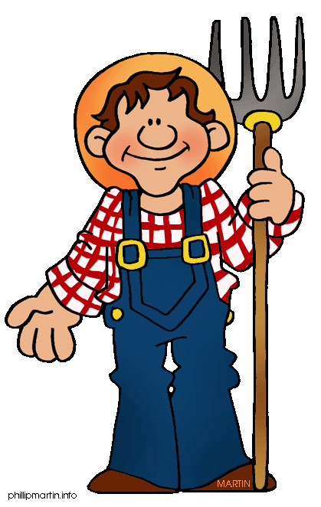
A person who grows corn, wheat, cows, pigs, etc.

Slide 8
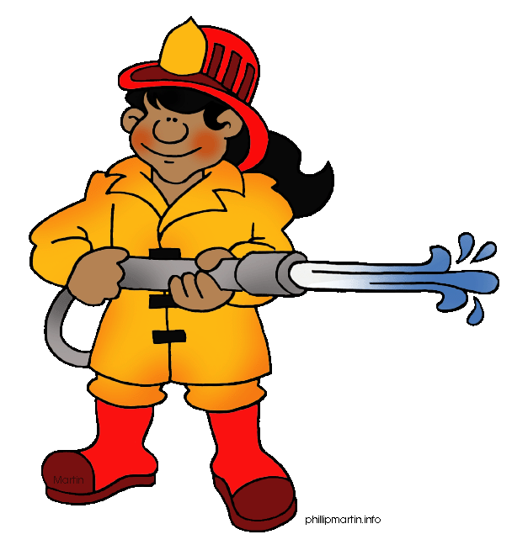
A person who extinguishes fires in houses and buildings.

Slide 9
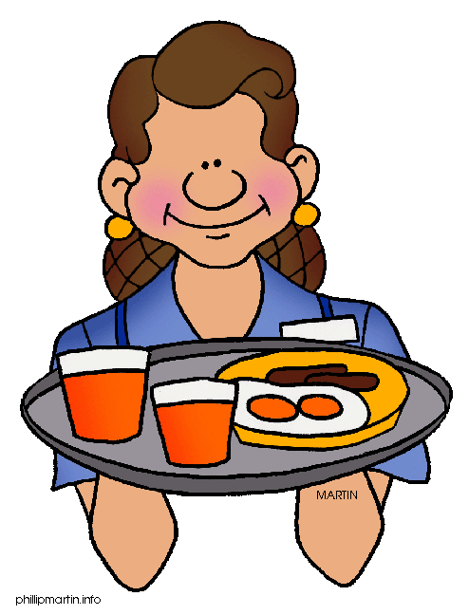
The person who brings you food
and drinks in a restaurant,
café, etc.

Slide 10
Those persons try to teach you at school some education.

Slide 11
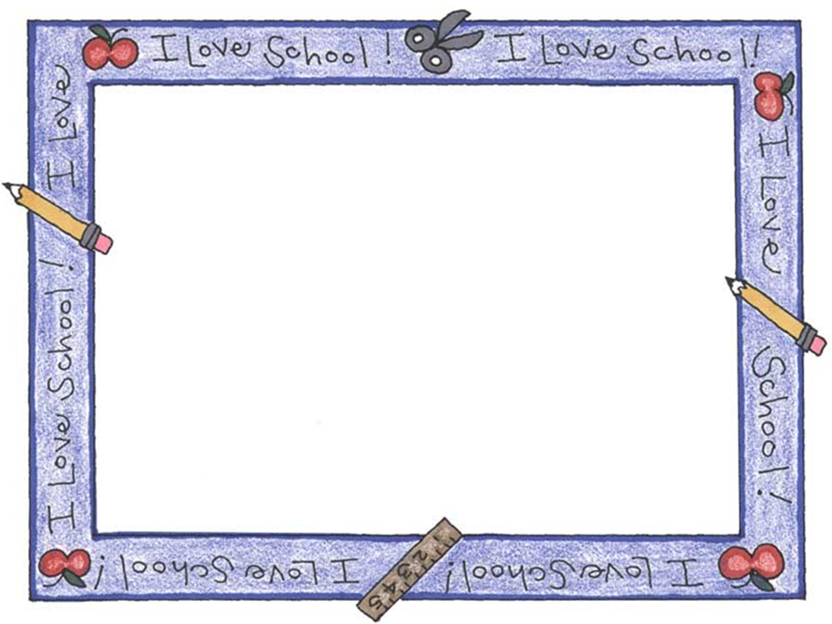
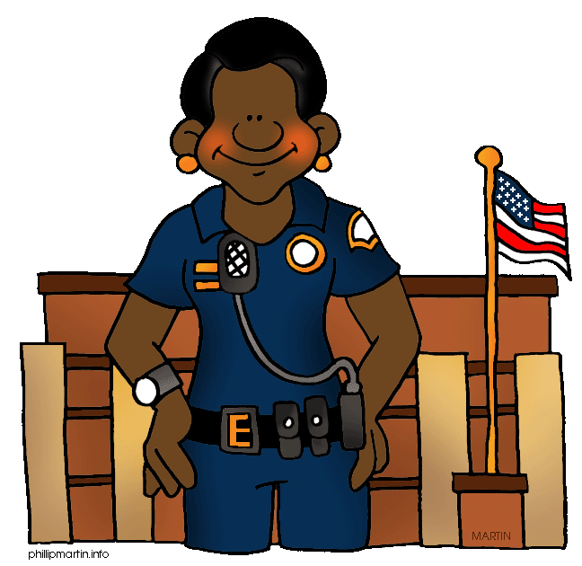
Those persons take care of buildings, by night and at the weekend.

Slide 12
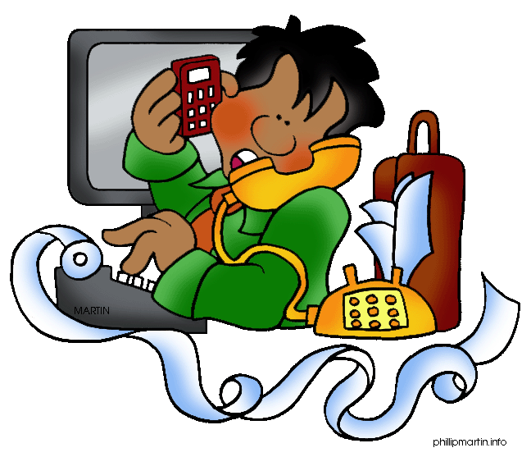
Someone who does all the writing and telephoning in an office.

Slide 13
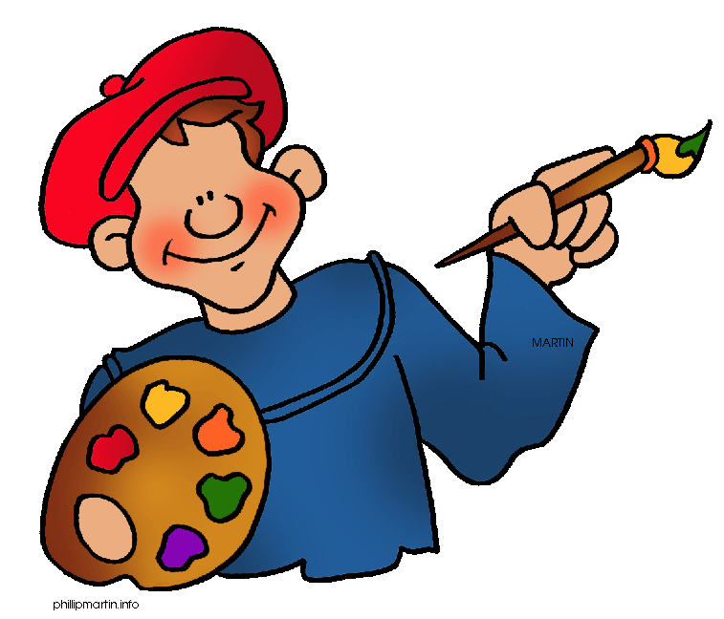
Someone who paints paintings.

Slide 14
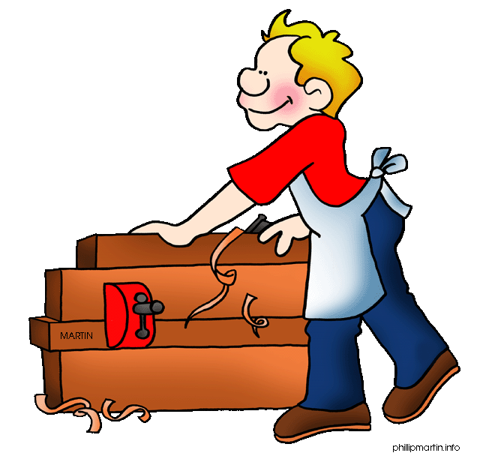
Someone who works with wood and creates furniture.

Slide 15
This man makes sure that our streets are good enough.

Slide 16
He / She takes care of traffic rules, prevents crime or chases robbers.

Slide 17
Someone who serves the army.

Slide 18
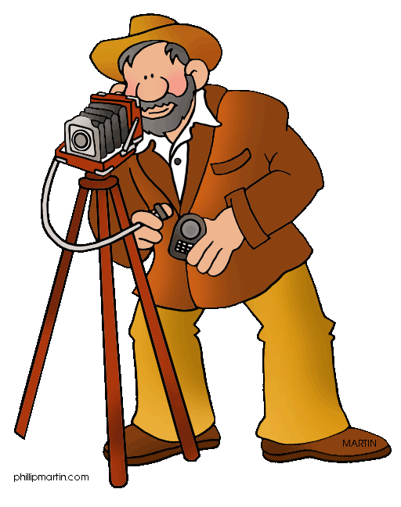
Someone who takes photos.

Slide 19
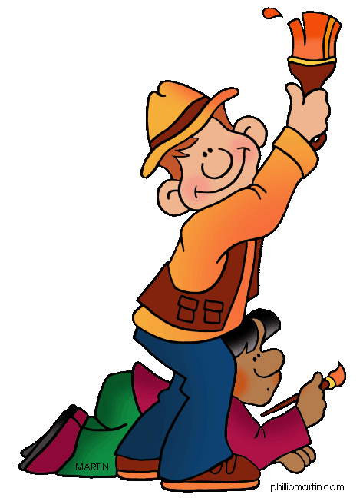
Someone who can decorate and paint your walls.

Slide 20
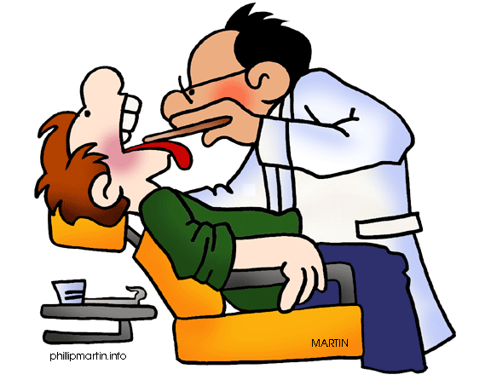
Someone who cares about your teeth.

