Slide 1
PRESENT SIMPLE
GAME
Choose the right option.

Slide 2
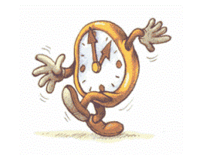
The alarm clock …Time to get up.
GREAT
ring
rings
ringes

Slide 3
Mr. Black … a cup of coffee.
GREAT
drinks
drank
drink

Slide 4
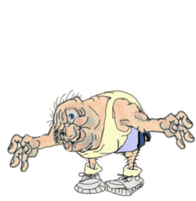
He…some exercise.
GREAT
make
do
does

Slide 5
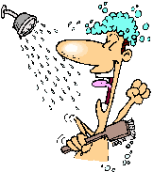
Then he…a shower.
GREAT
haves
has
have

Slide 6
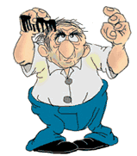
He … his hair.
GREAT
combs
comb
combes

Slide 7
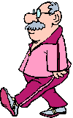
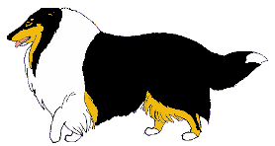
He…the dog before leaving home.
GREAT
walk
walkes
walks

Slide 8
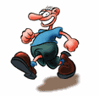
He …to the park.
GREAT
runs
rans
run

Slide 9
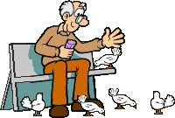
He…the pigeons.
GREAT
feed
feeds
feds

Slide 10
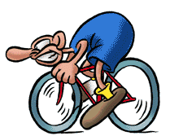
He…back home.
GREAT
rodes
ride
rides

Slide 11
He … the flowers.
GREAT
water
waters
wateres

Slide 12
Then he… his lunch.
GREAT
prepars
prepare
prepares

Slide 13
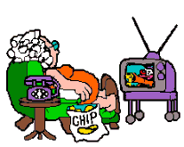
His wife always… TV in the morning.
GREAT
watching
watches
watch

Slide 14
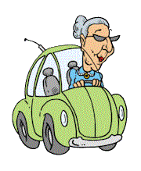
After lunch she … to town.
GREAT
droves
drive
drives

Slide 15
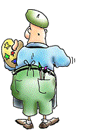
Mr Black… in the afternoon.
GREAT
paint
painting
paints

Slide 16
Then he…the floor.
GREAT
sweps
sweep
sweeps

Slide 17
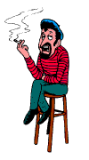
Before going to bed he… a cigarrette.
GREAT
smoks
smokes
smoke

Slide 18
He … to bed at midnight.
GREAT
gos
goes
go

