Slide 1
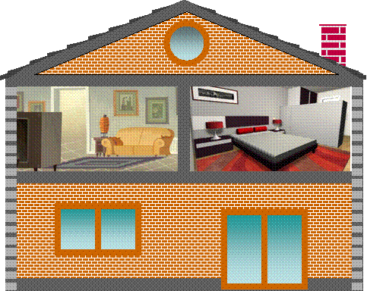
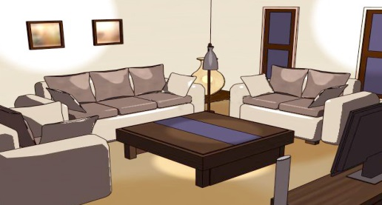
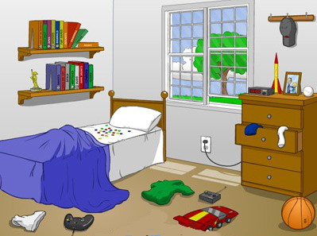
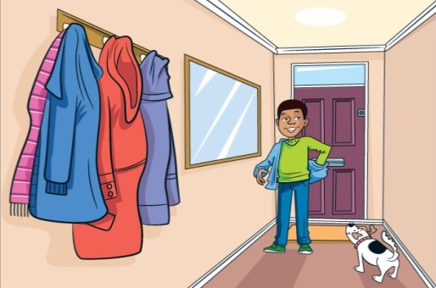
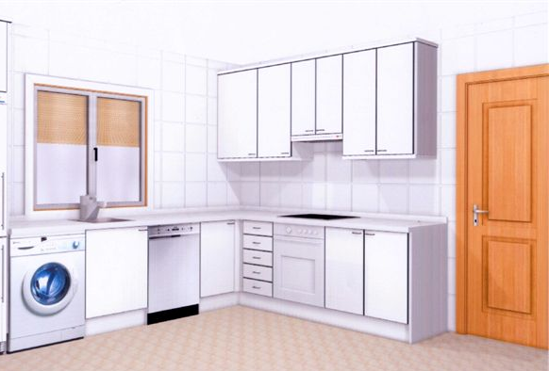
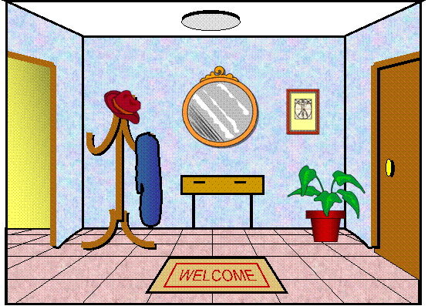

Slide 2
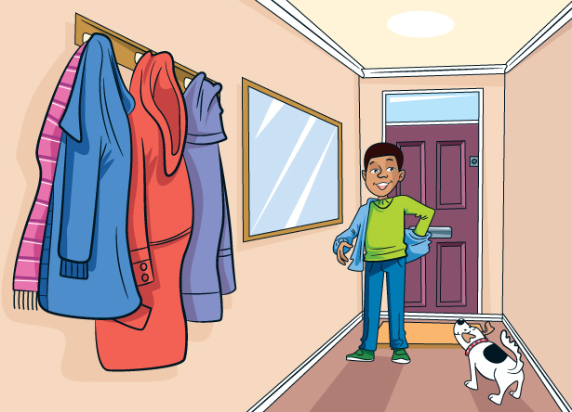
1 / 13
hallway

Slide 3
2 / 13
living room

Slide 4
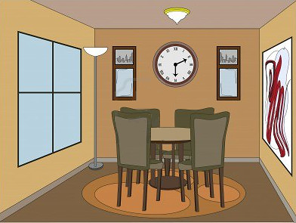
3 / 13
dining room

Slide 5
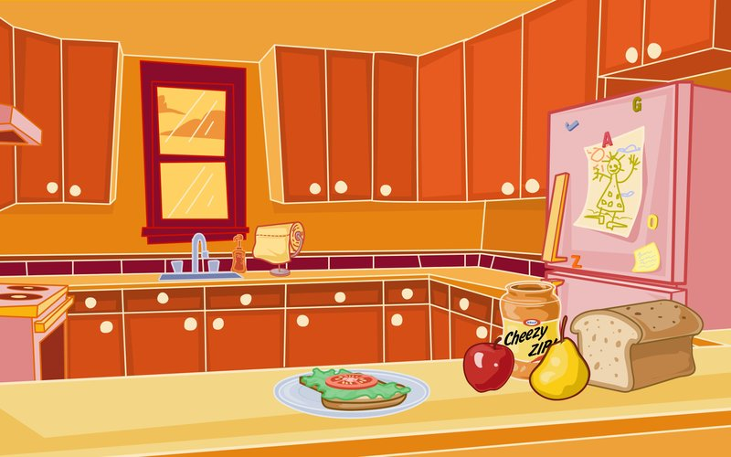
4 / 13
kitchen

Slide 6
5 / 13
bedroom

Slide 7
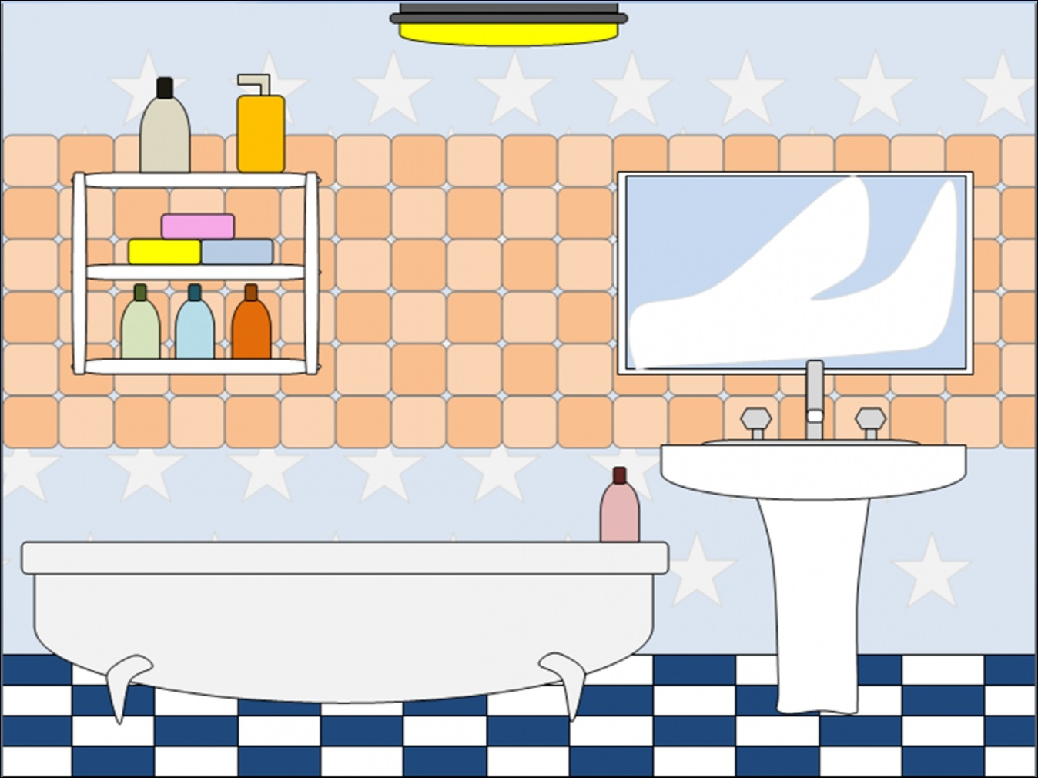
6 / 13
bathroom

Slide 8
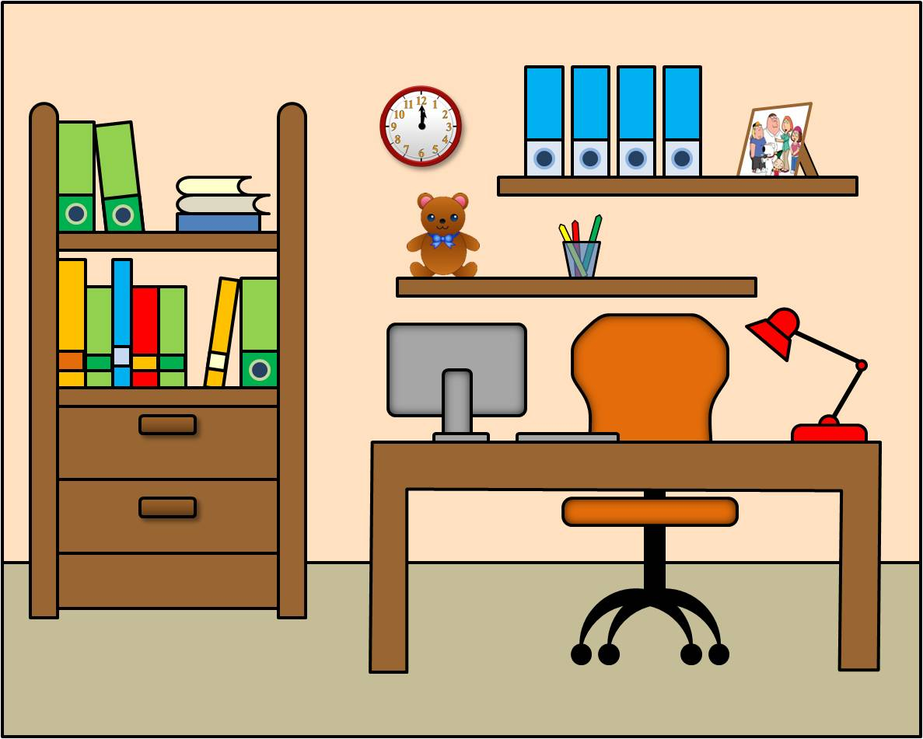
7 / 13
study room

Slide 9
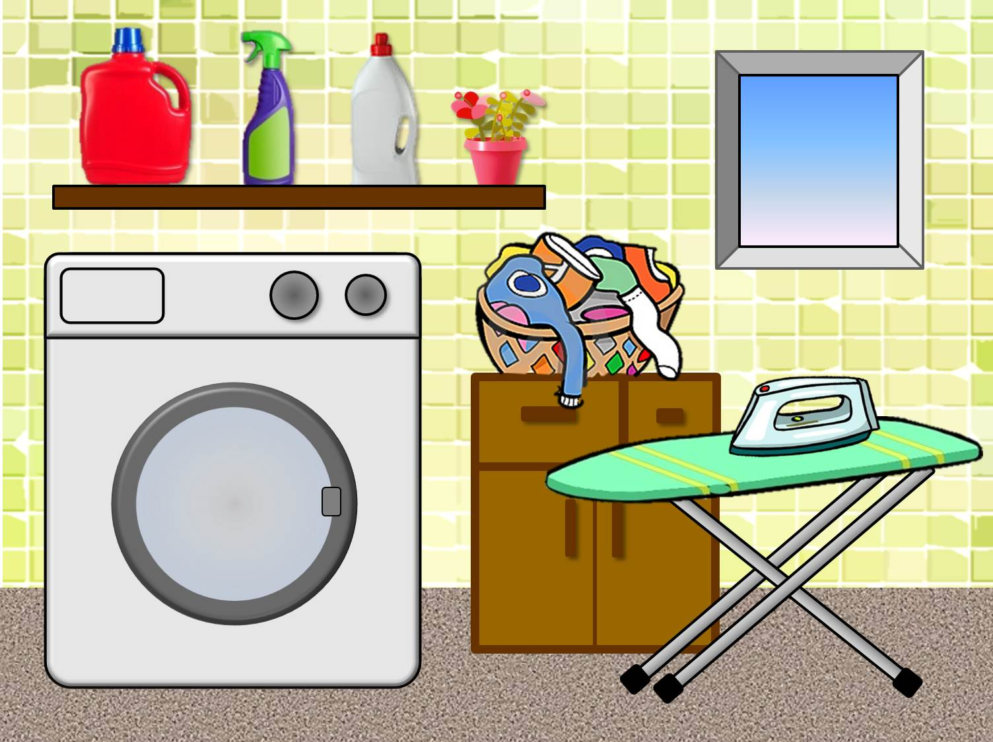
7 / 13
laundry room

Slide 10
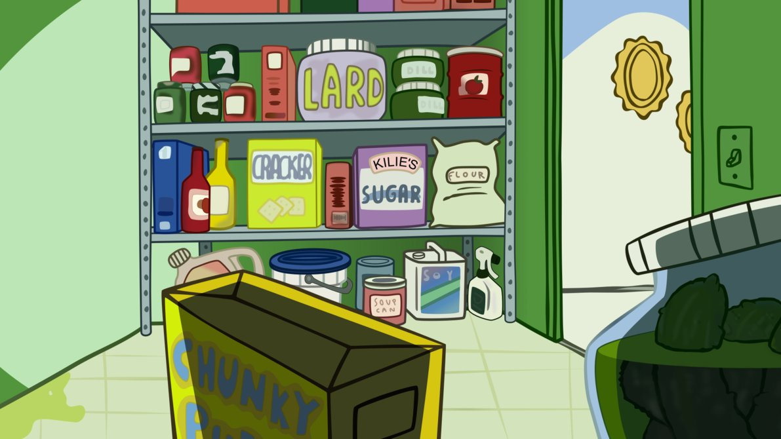
8 / 13
pantry

Slide 11
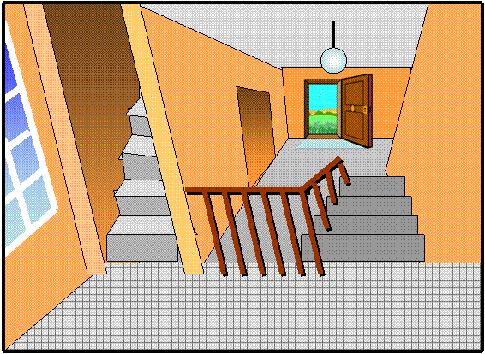
9 / 13
stairs

Slide 12
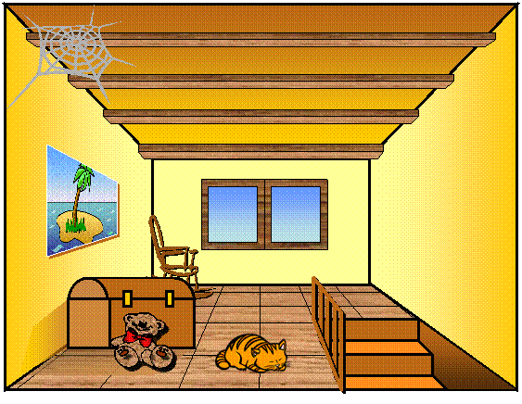
10 / 13
attic

Slide 13
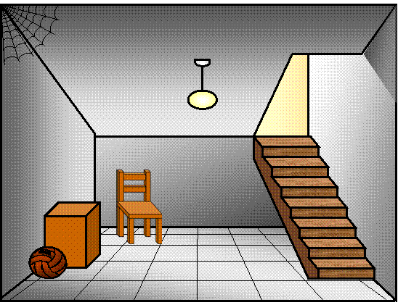
11 / 13
basement

Slide 14
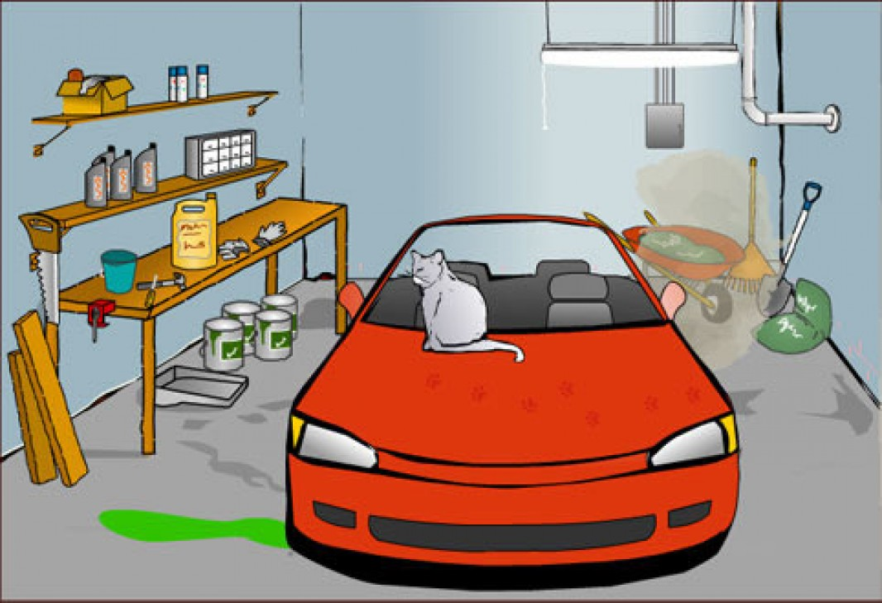
12 / 13
garage

Slide 15
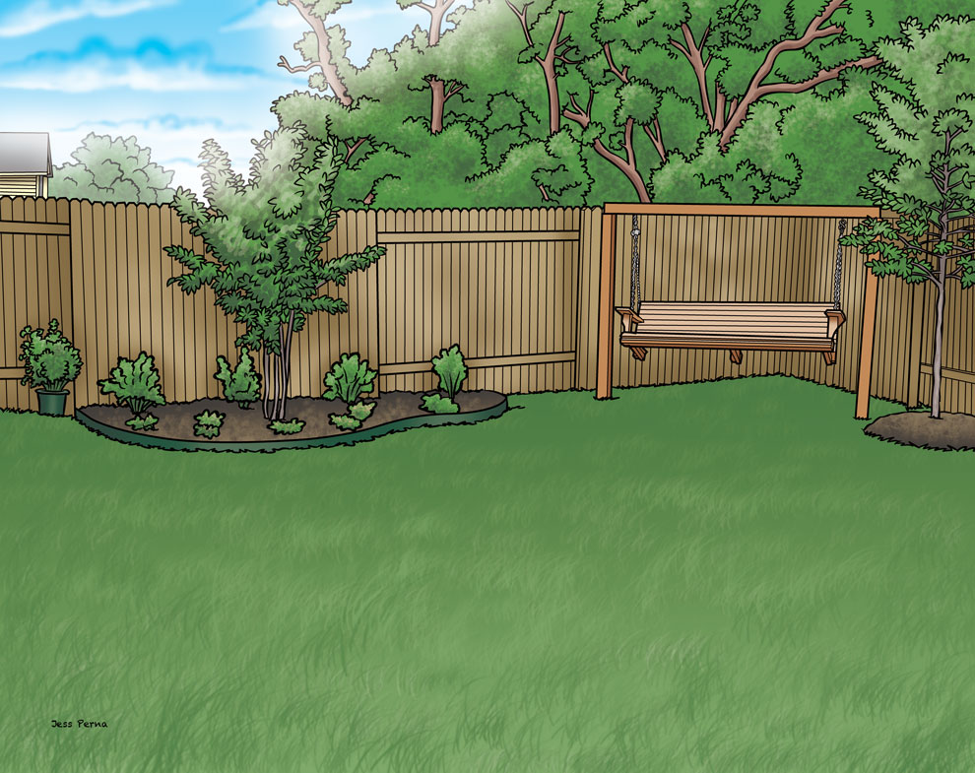
13 / 13
backyard

Slide 16
We wash and iron our clothes in the …
laundry room

Slide 17
I do my homework in the …
study room

Slide 18
I play with my dog in the …
backyard

Slide 19
I wash my hands and clean my teeth in the …
bathroom

Slide 20
I sleep and get dressed in my …
bedroom

Slide 21
My parents cook the meals in the …
kitchen

Slide 22
We keep food and other things in the …
pantry

Slide 23
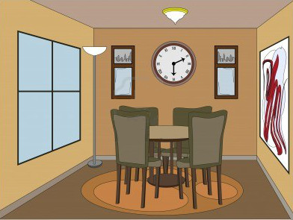
We have dinner in the …
dining room

Slide 24
I watch TV with my family in the …
living room

Slide 25
I take out my coat and clean my shoes when I arrive home in the…
hallway

Slide 26
My parents keep the car in the …
garage

Slide 27
This room is under the ground floor.
basement

Slide 28
This room is under the roof of my house.
attic

