Slide 1
Introduce yourself

Slide 2
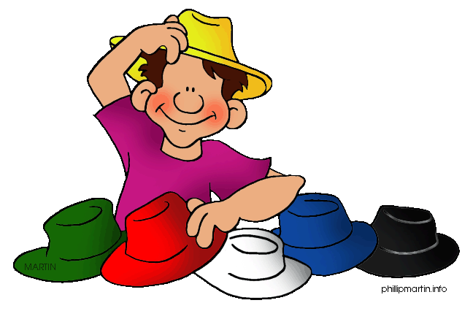
What’s your mother’ job?
What’ your father’s job?

Slide 3
What would you like to be? Why?

Slide 4
• What’s your hobby?
• What do you like doing in your free time?

Slide 5
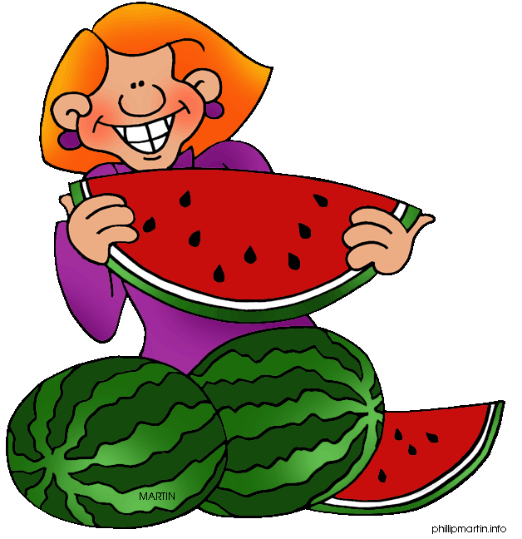
What’s your name?
What’s your favourite food?

Slide 6
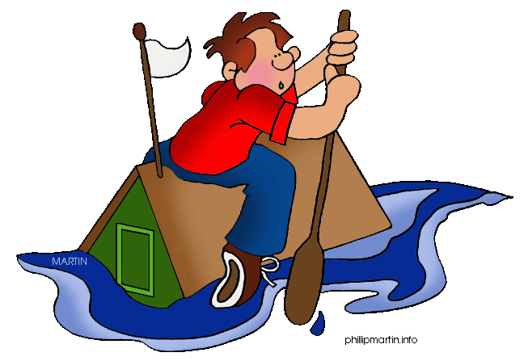
What don’t you like doing ?
Do you like travelling?

Slide 7
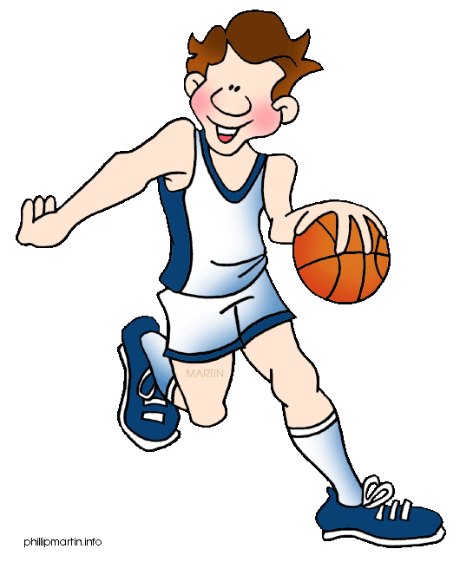
How old are you?
What’s your favourite sport?

Slide 8
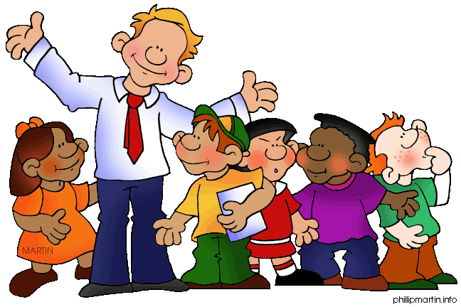
How many people are there in your family?
Who are they?

Slide 9
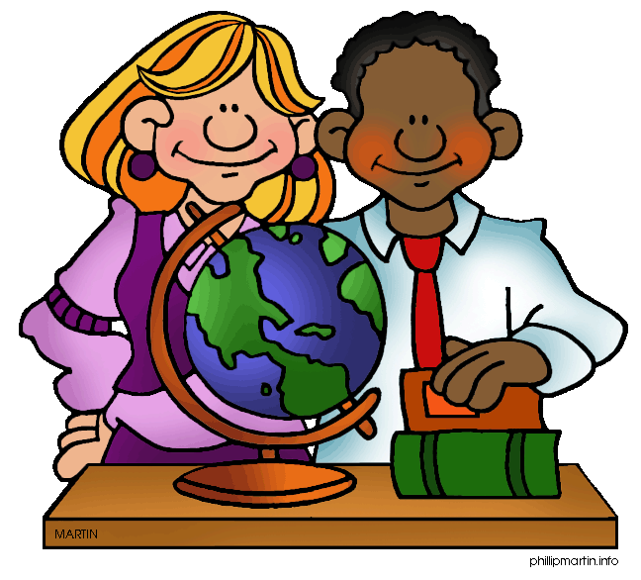
Where do you go to school?
How do you go to school?
What’s your favourite subject?

Slide 10
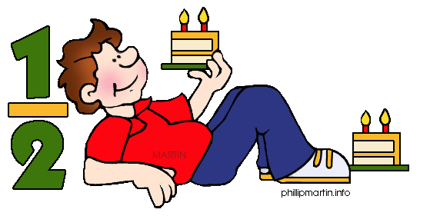
Where do you live?
When is your birthday?

Slide 11
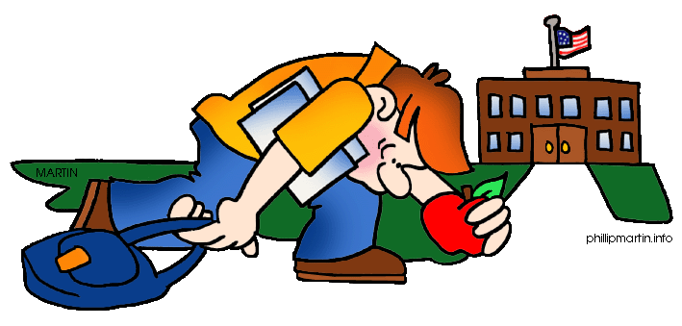
•What’s your favourite day of the week?
•Why?

Slide 12
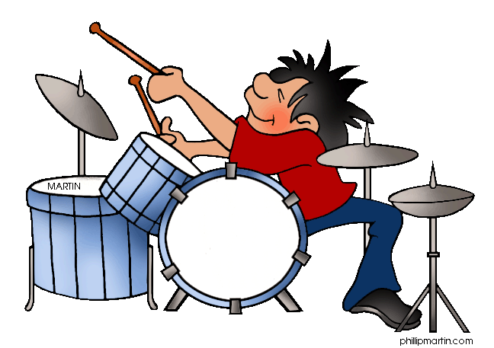
Why do you study English?
What’s your favourite band?

Slide 13
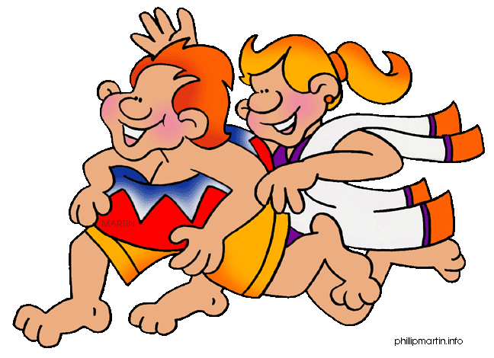
What’s your favourite month?
Why?

Slide 14
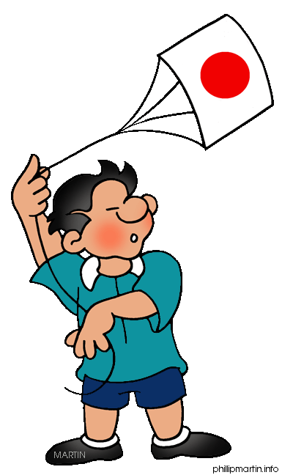
What’s your favourite drink?
Where are you from?

Slide 15
•What kind of movies do you like?
•How often do you go to the cinema?

Slide 16
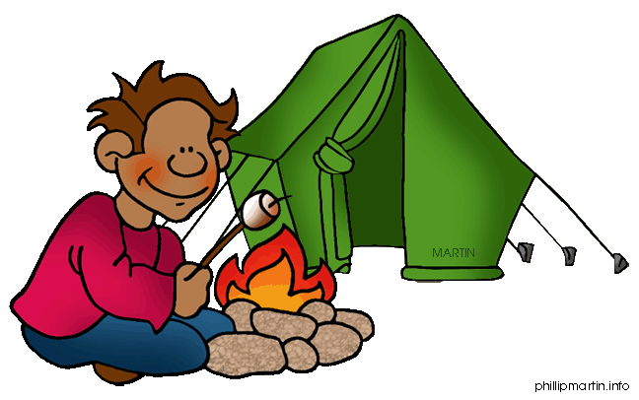
What’s the most beautiful place in your country?
What’s your favourite place?
Why do you like it?

Slide 17
THANK YOU VERY MUCH.

