Slide 1


Slide 2
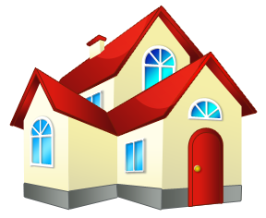


1 / 38
house

Slide 3

2 / 38
neighborhood

Slide 4

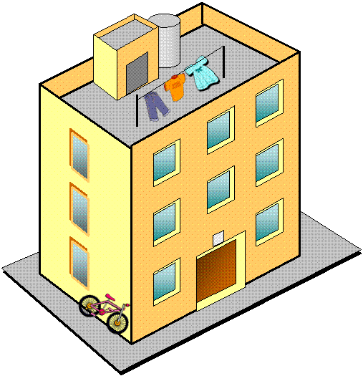
3 / 38
block of flats

Slide 5
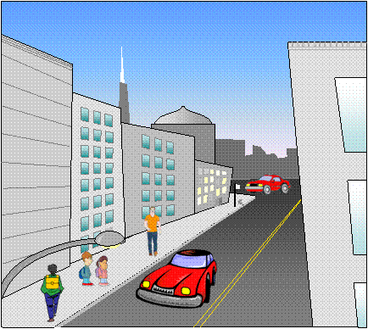
4 / 38
street

Slide 6
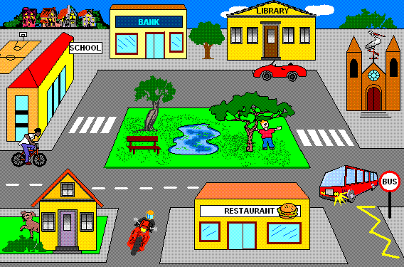
5 / 38
square

Slide 7
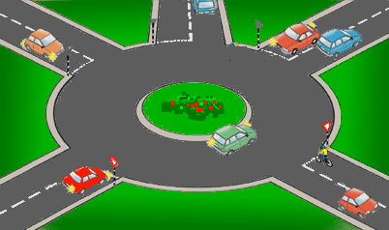
6 / 38
roundabout

Slide 8
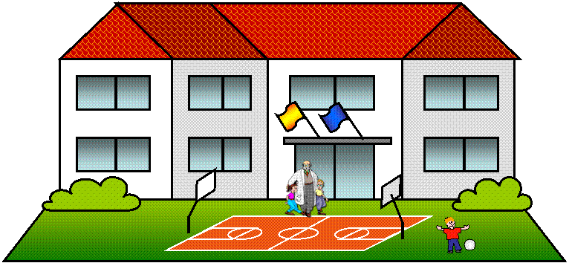
7 / 38
school

Slide 9
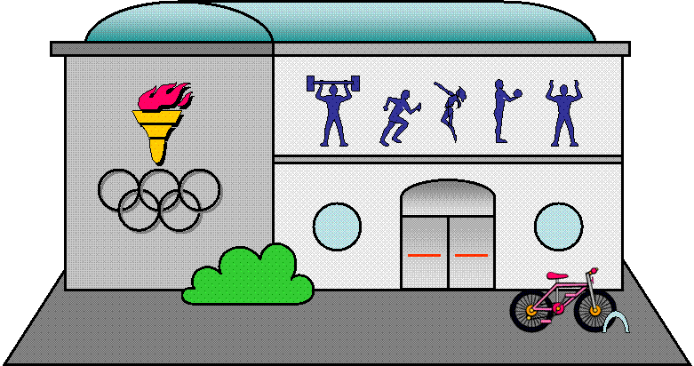
8 / 38
sports centre

Slide 10
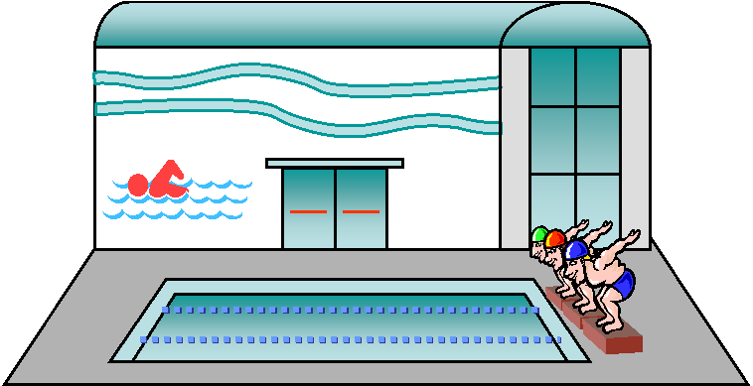
9 / 38
swimming pool

Slide 11
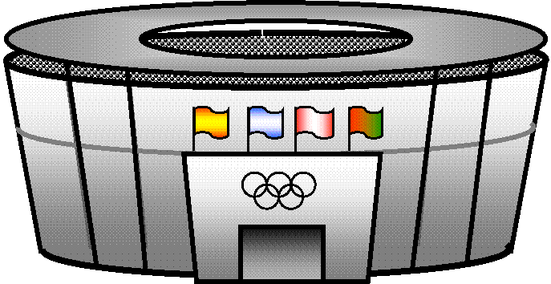
10 / 38
stadium

Slide 12
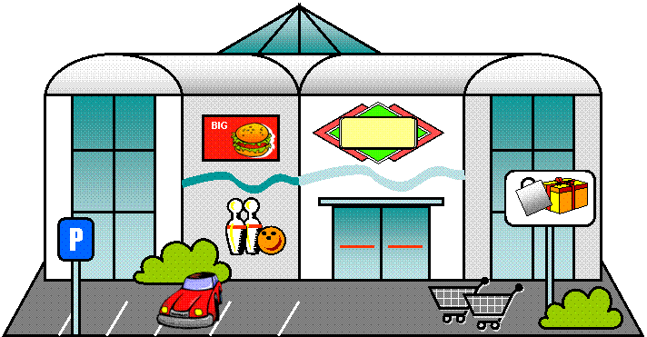
11 / 38
shopping centre

Slide 13
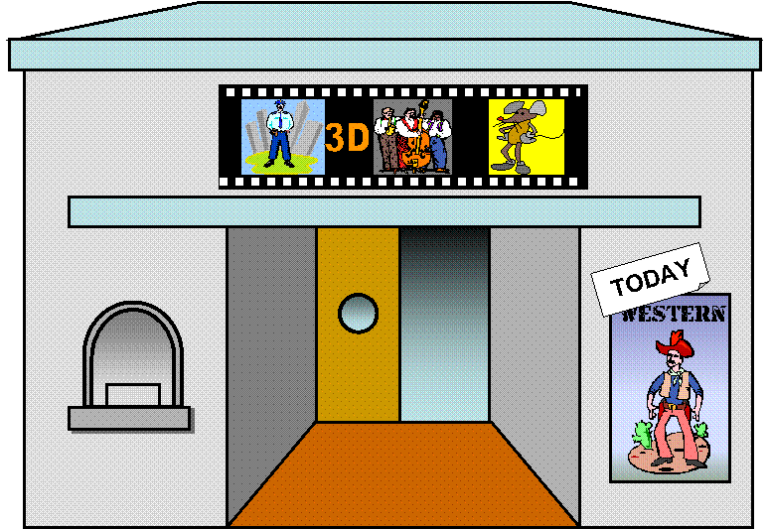
12 / 38
cinema/movie theatre

Slide 14
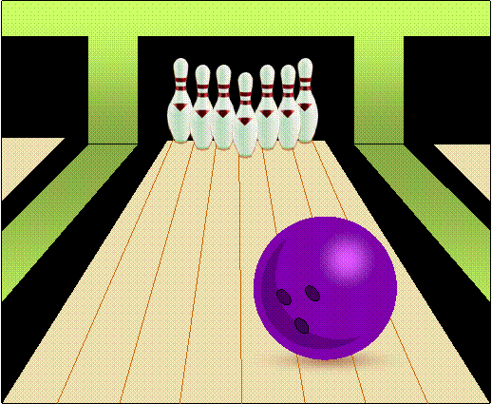
13 / 38
bowling alley

Slide 15
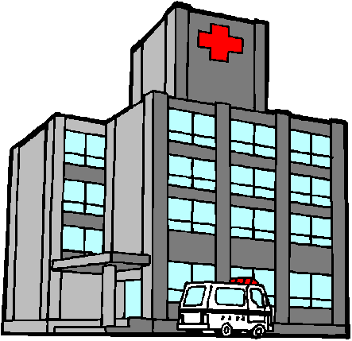
14 / 38
hospital

Slide 16
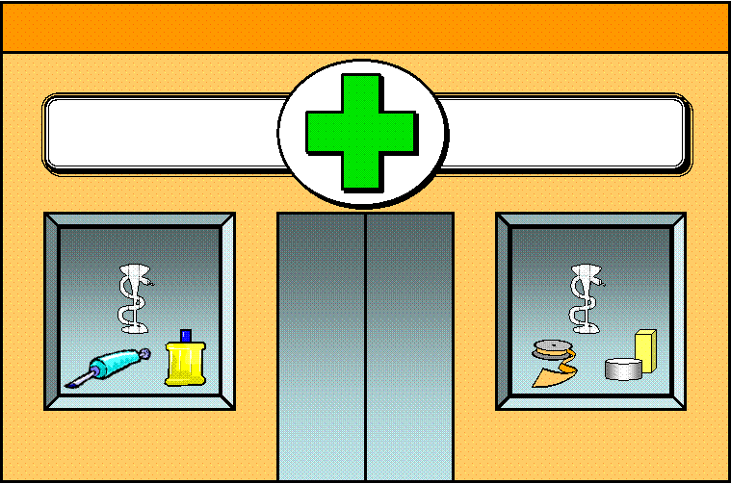

15 / 38
chemist’s/pharmacy

Slide 17
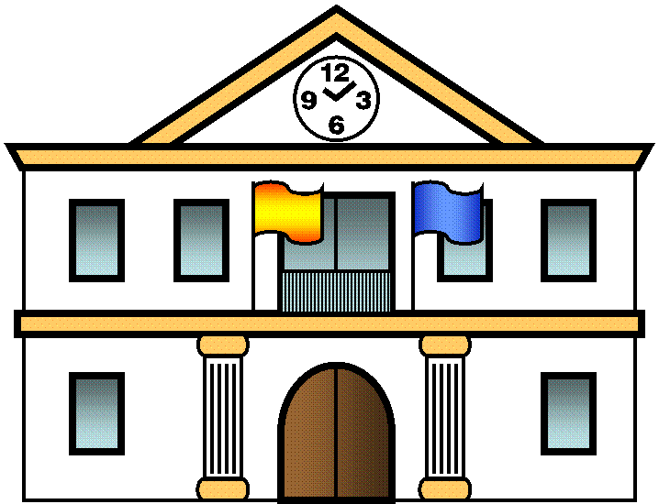
16 / 38
town hall

Slide 18
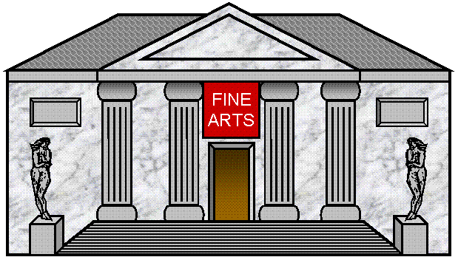
17 / 38
museum

Slide 19
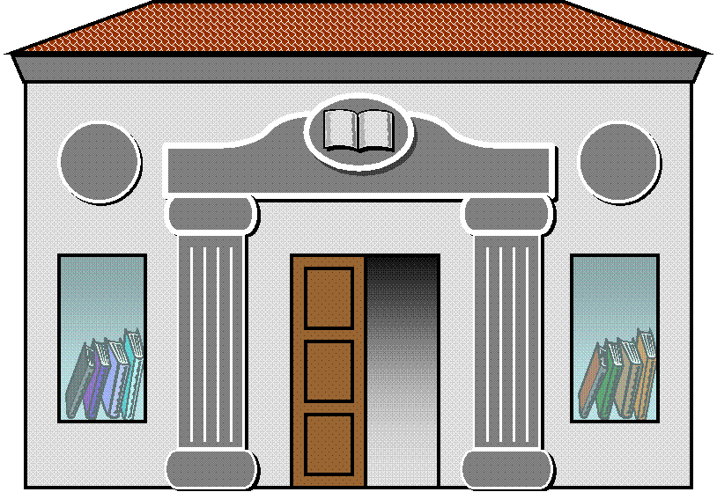
18 / 38
library

Slide 20
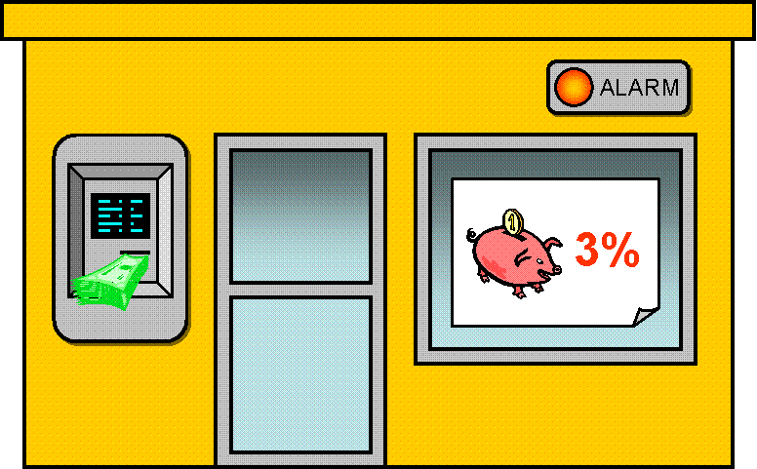
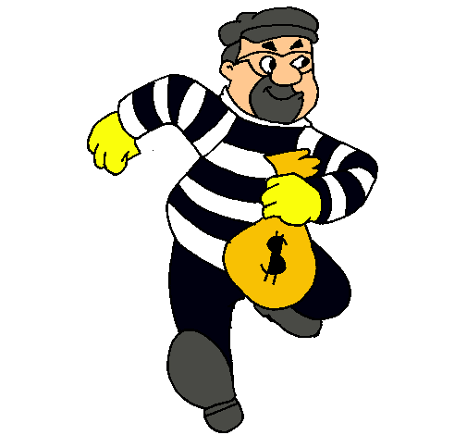
19 / 38
bank

Slide 21
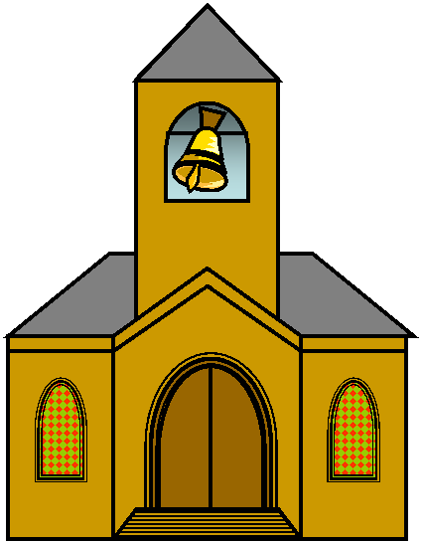
20 / 38
church

Slide 22
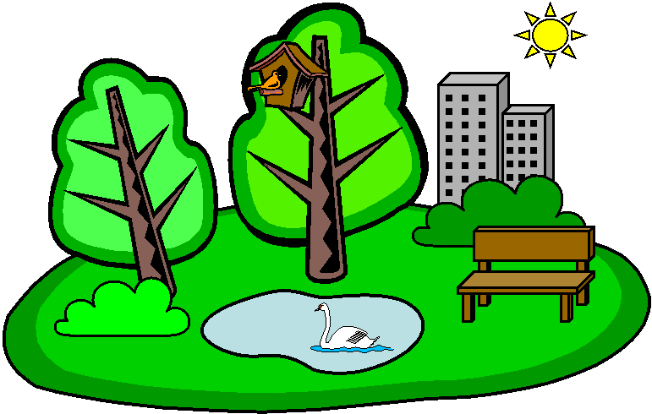
21 / 38
park

Slide 23
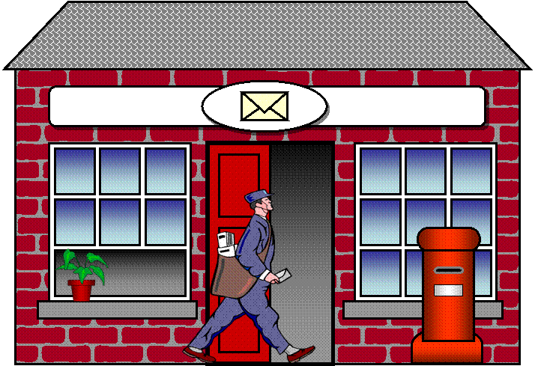
22 / 38
post office

Slide 24
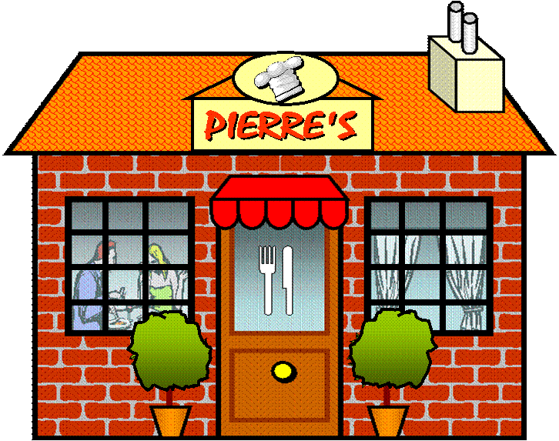
23 / 38
restaurant

Slide 25
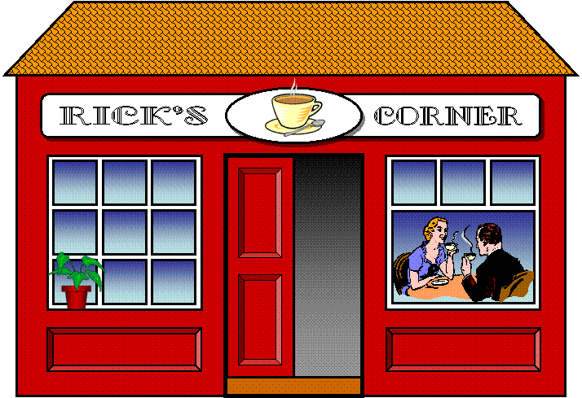
24 / 38
café

Slide 26
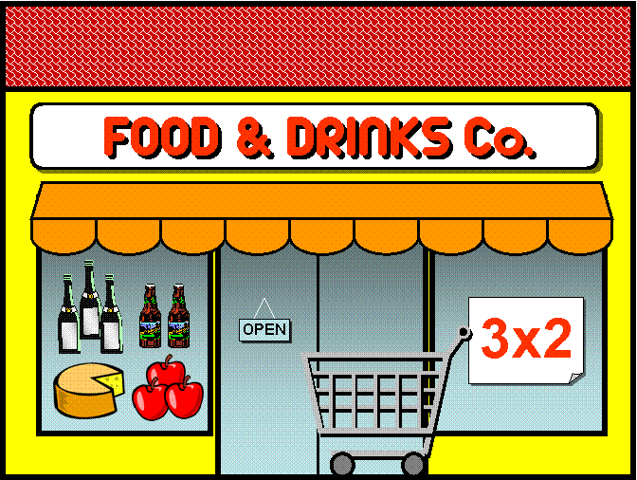
25 / 38
supermarket

Slide 27
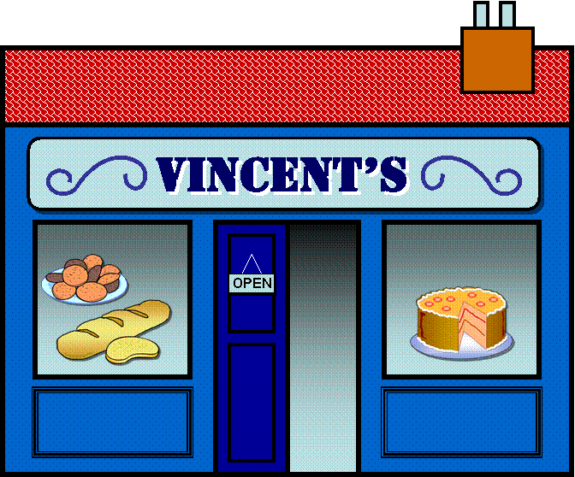
26 / 38
bakery

Slide 28
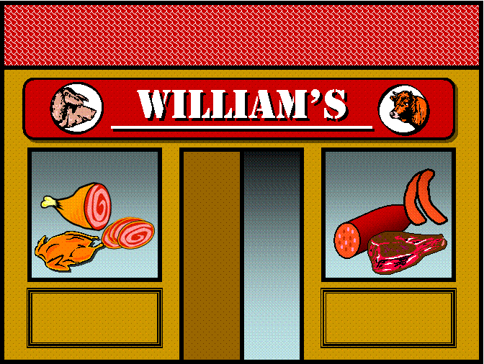
27 / 38
butcher shop

Slide 29
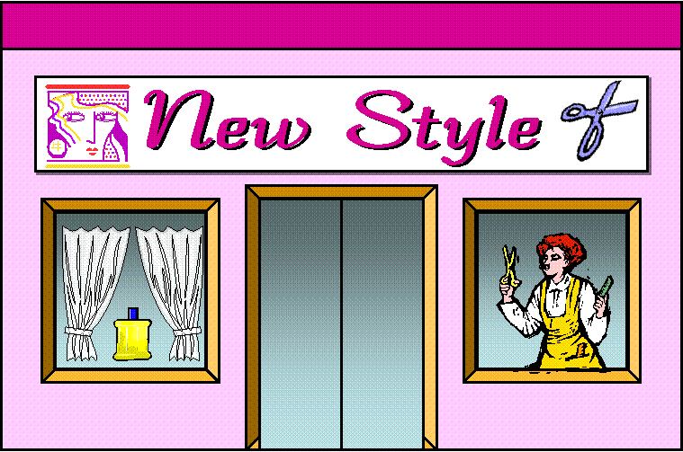
28 / 38
hairdresser’s

Slide 30
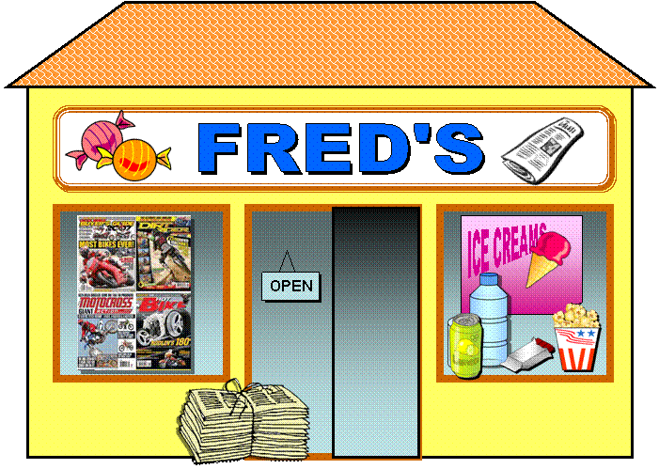
29 / 38
newsagent’s

Slide 31
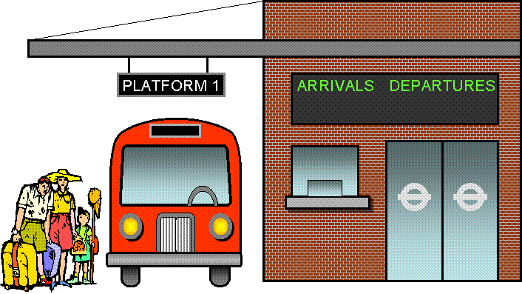
30 / 38
bus station

Slide 32
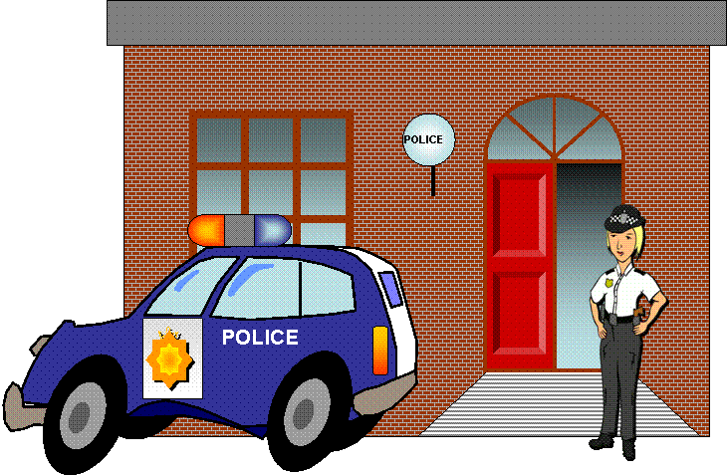
31 / 38
police station

Slide 33
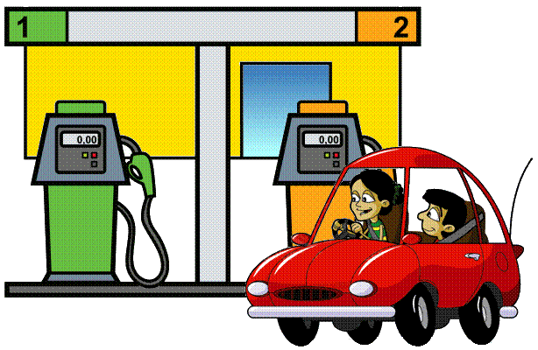
32 / 38
petrol/gas station

Slide 34
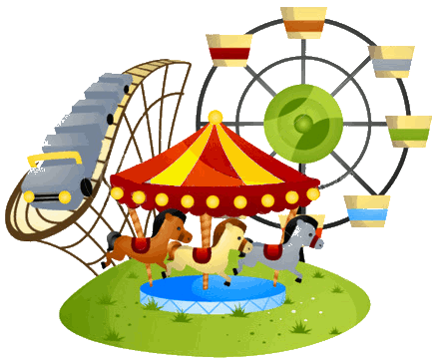
33 / 38
theme park

Slide 35
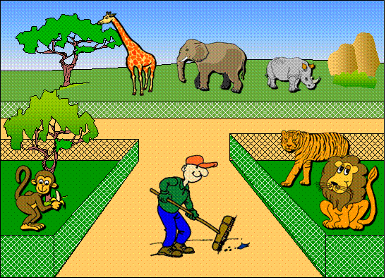
34 / 38
zoo

Slide 36
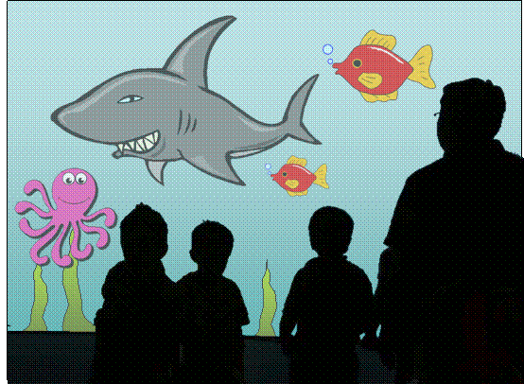
35 / 38
aquarium

Slide 37
36 / 38
ice rink

Slide 38
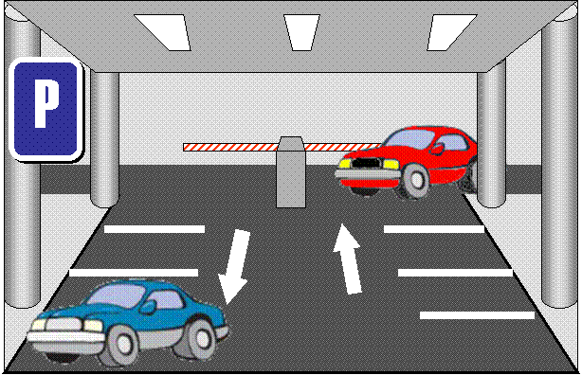
37 / 38
ENTRANCE
EXIT
car park

Slide 39
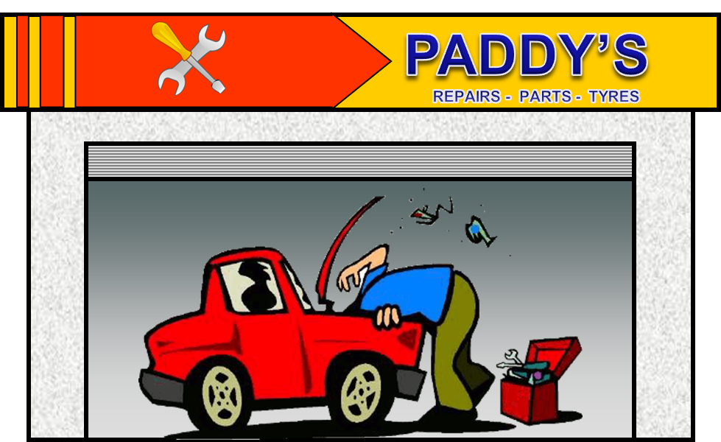

38 / 38
garage

